Slide 1

Network Traffic Analysis with
Malcolm Development Team • Cybersecurity R&D • Idaho National Lab
Notes:
Network traffic analysis is all about getting to the “important stuff” as quickly as possible.
There are many open source and proprietary tools available for analyzing raw packet capture (PCAP) files: WireShark, Network Miner, GrassMarlin, etc.
Analyzing PCAP sets that are large (or from complex networks) with many of these tools is difficult, as often they at best struggle and at worst outright fail to handle packet captures larger than a few hundred megabytes.
Today we’re going to talk about the open source network traffic analysis tool suite Malcolm, developed at the Idaho National Lab with support from the US Department of Homeland Security. You may be familiar with some or all of the open source tools which make up Malcolm: all are already available and in general use. What Malcolm provides a is a framework of interconnectivity which makes it greater than the sum of its parts, streamlining network traffic analysis and bringing that “important stuff” to the foreground as painlessly as possible.
This morning we’re going to talk about using Malcolm to gain insight into both link-layer and application-layer network traffic.

Slide 2
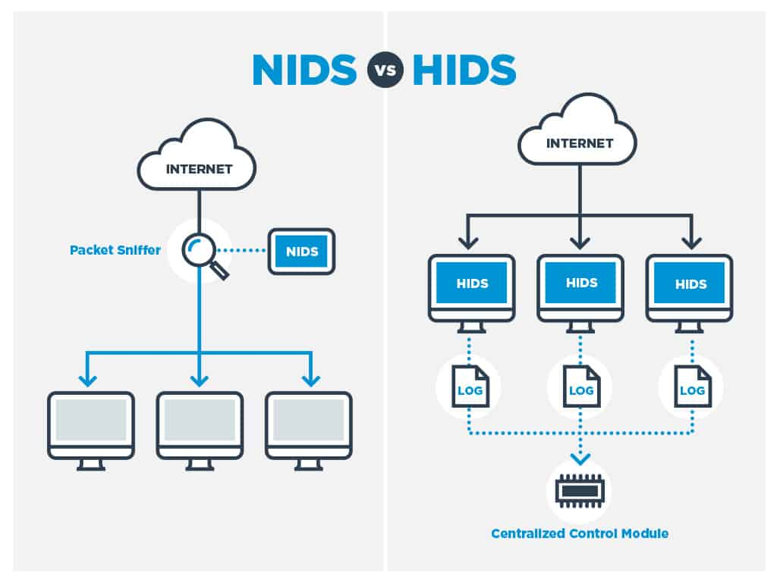
Intrusion Detection Systems
HIDS: Host Intrusion Detection Systems
  Agents run on individual hosts or devices on a network
NIDS: Network Intrusion Detection Systems
  Monitor and analyze network traffic for anomalies: suspicious activity, policy violations, etc.
  Generally passive/out-of-band; otherwise it’s an Intrusion Prevention System
  Detection methods
    Signature-based detection (e.g., Suricata)
    Statistical anomaly-based detection (e.g., Random Cut Forest)
    Stateful protocol analysis detection (e.g., Zeek)
comparitech.com
Notes:
Before we jump into our discussion about Malcolm and some of its primary components (like Zeek, the OpenSearch and Arkime), let’s take a minute and talk about intrusion detection systems so we can get an understanding of these tools fit into the threat detection landscape.
When talking about Intrusion Detection Systems, you’re usually going to be talking about tools in one of two categories:
Host Intrusion Detection Systems utilize a native agent that runs locally on individual hosts and network devices. These agents often monitor not only network traffic at the device NIC level, but also track modifications to critical system files, monitor user authentication events, or configuration changes, and report these events to a central manager for alerting and reporting. Host Intrusion Detection Systems are not what we are talking about today.
Network Intrusion Detection Systems are generally passive or out-of-band programs or devices that capture and analyze network traffic at strategic points within the network in order to monitor traffic among devices in the network or between network devices and the outside world.
This monitoring and analysis can be done concurrently (in other words, analyzing the traffic as it is captured), or the network traffic can be captured with other tools for later offline analysis. We are taking the latter of these approaches in this presentation.
An IDS is generally passive, meaning that it should not alter the network traffic as a side-effect of its analysis. Systems which actively drop suspicious network traffic are called Intrusion Prevention Systems.
There are several different approaches to IDS, and each has its pro’s and con’s.
Signature-based detection acts similarly to an anti-virus program, comparing the contents of network traffic to predefined patterns to look for known malicious behavior. While signature-based IDS is good for known attacks and is usually efficient from a resource standpoint, it is not effective at detecting new attacks
Statistical anomaly-based detection uses machine learning to create a baseline for trusted network behavior and compares new behavior against that baseline. This technique can be effective in detecting novel attacks, but can suffer from high false-positive rates and is computationally expensive.
Stateful protocol analysis detection uses knowledge of network protocols to look for deviations from profiles of generally accepted definitions of normal activity

Slide 3

IDS: Types of Attacks
Scanning Attack
  Determine network topology
  IDS highlights connections from one host
  to many other hosts in the network, or connection
  attempts to sequential IP addresses and/or ports
Denial of Service Attack
  Interrupt service by flooding requests or flaws in protocol implementations
  IDS identifies large volume of traffic from or to a particular host or invalid connection states (e.g., TCP SYN/ACK with no ACK)
Penetration Attack
  Gain access to system resources by exploiting a software or configuration flaw
  Trickier, but IDS may detect vulnerable software versions or simply alert on unusual operations (e.g., a “write” operation in an already-configured environment with mostly “read” operations)
Notes:
What type of intrusions or attacks might we hope to uncover using intrusion detection system?
A scanning attack is used to assimilate information about a system or network being attacked. By attempting connections to a range of IP addresses within a network and scanning for open ports (responding services) on those hosts, an attacker puts together a map of the topology of the network: types of network traffic allowed through a firewall, active hosts on the network, the operating system, kernel, and software versions running on those hosts, etc. This information can then be used to launch attacks aimed at specific exploits. A good IDS should be able to notice these types of accesses (possibly seen as sequential connections from one host to a range of IP address or ports) and alert that a host scan or port scan took place.
Denial of service attacks work by flooding a network or host with an overwhelming number of connections or requests. This could be something as simple as sending a large number of “ping” packets (ping flood), or by forging the initiation of a TCP connection (SYN flood) causing the host to be unable to respond to legitimate connections. Intrusion detection systems are good at categorizing traffic from or to a particular host or service, and can often track things like connection state for various network protocols, making identifying this type of attack easier to identify.
Finally, a penetration attack is any type of attack which give an unauthorized attacker the ability to access system resources, privileges, or data by exploiting a misconfigured system or a software flaw. These types of attacks are more difficult to identify because once an attacker has a foothold on a system in a network it becomes much easier for them to cover their tracks and mask commands as normal network traffic. This is particularly true with custom, targeted, and “zero day” exploits for which the attack vector is not previously known and there are not signatures or logic to detect them. However, IDS systems are still valuable in identifying penetration attacks when they are protocol-aware, allowing analysts to recognize changes in pattern or unusual operations in the context of normal network traffic.

Slide 4




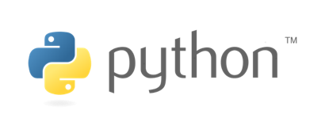
Extensible, open-source passive network analysis framework
More than just an Intrusion Detection System:
  Packet capture (like )
  Traffic inspection (like )
  Intrusion detection (like )
  Log recording (like NetFlow and syslog)
  Scripting framework (like )
Notes:
Zeek (formerly Bro) is one of two PCAP analyzing engines used by Malcolm to generate ”metadata” about network traffic, which metadata is indexed and made searchable through Malcolm’s visualization tools. Let’s discuss Zeek’s capabilities to better understand what it offers analysts as a Malcolm data source.
So where does “Zeek” come into the picture? What is Zeek? While it’s sometimes referred to as “Zeek IDS,” and it incorporates some of the techniques from the previous slide, Zeek is more than just an intrusion detection system.
Zeek is an extensible open-source passive network analysis framework, featuring:
packet capture
traffic inspection
intrusion detection
Flow log recording
a scripting and data structure framework for log enrichment
If I had to categorize Zeek itself into one of the three detection method categories from the previous slide, I’d categorize it in the “Stateful protocol analysis detection” camp: Zeek’s network traffic parsers examine network traffic at the application layer and reports the behaviors of hosts communication over those protocols. These logs can then be used to do more in-depth manual or automated analysis, as we’ll see throughout our discussion.

Slide 5
Strengths 👍 | Weaknesses 👎
Analyzes both link-layer and application-layer behavior Content extraction Behavioral analysis Session correlation Can add support for uncommon protocols through scripts/plugins | Session metadata only (not full payload) Setup and configuration can be complicated Produces flat textual log files which can be unwieldy for in-depth analysis
Notes:
Zeek is fundamentally different from other IDS, in that it goes beyond pure signature matching in favor of analyzing the application-layer behavior of hosts themselves (although it does have also have signature matching capabilities similar to Yara or Snort).
Zeek’s features can be combined in powerful ways to provide insight into network traffic. With Zeek logs, a network analyst can perform:
content extraction – for example, extract exfiltrated files from PCAPs for further examination
behavioral analysis and session correlation – as Zeek is highly stateful, extensively tracking application-layer network state, it can be used to determine “what else” took place in the communication between two hosts, or what preceded a suspicious event
extensible – support for uncommon protocols (for example, OT protocols) can be added via scripts and plugin architecture
Zeek is a powerful tool commonly used in network traffic analysis, but it does have its own set of hurdles. In a minute we’ll see how Malcolm helps overcome these hurdles.
While Zeek does provide its own packet capture abilities (for example, sniffing for traffic on an interface connected to a network tap on a switch), in the context of this presentation we will be focusing on the use of Zeek (as a component of Malcolm) to perform post-capture network analysis, i.e., against PCAP files gathered previously.

Slide 6
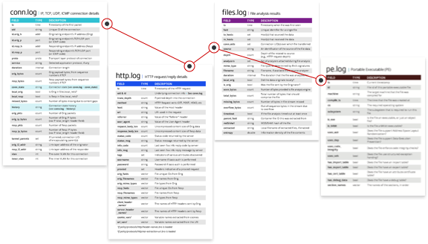
Zeek Log Files
Network
Protocols
Files
Detection
Network
Observations
corelight.com
Notes:
As Zeek analyzes network traffic, it generates a number of .log files containing the events it detected.

Slide 7
Network Protocols
conn – Network session tracking
  Identified by session 4-tuple (originating IP:port, responding IP:port)
  One session (line in a log file) for every IP connection
  Unique identifier (UID) ties lines from other logs to a session
http , modbus , ftp , dns, etc.
  Protocol-specific log files created as traffic is seen
  Contain application-layer metadata about network activities
Notes:
conn.log is the “backbone” of a Zeek analysis. Each line of this file represents a unique network session, identified by a 4-tuple consisting of originating (i.e.., source) IP and port and response (i.e.., destination) IP and port.
Each connection in conn.log is assigned a random 18-character unique identifier (UID).
A particular session’s UID from conn.log will be referenced in any other Zeek log files generated for that same PCAP.
So, for example, in the case of an HTTP session between a web browser and a web site, there may be one line representing the entire session in conn.log, and many lines in http.log, each representing a different HTTP request belonging to that same session, referencing that connection’s UID.
There are many protocol-specific log files Zeek will generate. Taking note of which log files are generated from a network trace can provide insight into a potential breach even before you begin analyzing the files’ contents.
For example, if ssh.log was generated for a PCAP captured on a network where no SSH servers should be exposed, that could indicate that an attacker has opened an SSH service as a backdoor into the network after having compromised it through some other means.
The dhcp.log may provide useful in an assessment when identifying approved network devices, particularly those that communicate wirelessly, by their MAC and associated IP addresses.

Slide 8
Files
files – File analysis results
  Each transferred file identified with FUID
  Associated with connection UID(s) over which file was transferred
  File name, mime type, file size, etc. provided when available
pe – Analysis of Portable Executable (PE) files
  Target platform, architecture, OS, etc. for executables transferred across the network
x509 – Analysis of X.509 public key certificates
Notes:
Zeek has a file analysis engine that attempts to detect and identify when file transfers occur. Similar to connections, each file is assigned a random file unique identifier (FUID) that can be referenced in other log files. For example, a file transferred over HTTP may be referenced by its FUID in http.log, then more information could be found in files.log about that file. Entries in files.log may also be linked to the sessions during which they were transferred in conn.log by connection UID.
When possible, Zeek will identify the filename, mime type, file size, and other attributes of the file during file analysis.
Two specific types of files are Zeek out into their own log file: pe.log contains entries for portable executable files (as these may be of special interest when it comes to network security analyses), and x509.log which contains information about X509-formatted public key certificates.
x509.log, along with ssl.log, and other log files detailing events occurring over encrypted channels can help identify encryption schemes employed.

Slide 9
Detection
notice – Zeek concept of “alarms,” notices draw extra attention to an event
  Conn::Content_Gap, DNS::External_Name, FTP::Bruteforcing, Heartbleed::SSL_Heartbeat_Attack, HTTP::SQL_Injection_Attacker, Scan::Address_Scan, Scan::Port_Scan, Software::Vulnerable_Version, SSH::Password_Guessing, SSL::Certificate_Expired, Weird::Activity, …
  https://docs.zeek.org/en/stable/zeek-noticeindex.html
Notes:
The primary log file of interest from this list is notice.log.
A “notice” is Zeek’s concept of an alarm: a way to draw extra attention to an event.
Notices can be generated from any other Zeek script as it is processing traffic.
Zeek currently implements about 50 notices by default, and Malcolm adds several more, ranging from brute-force SSH login attempts to SQL injection attacks to expired SSL certificates and more.

Slide 10
Detection (cont.)
weird – Unexpected network-level activity
  > 150 weirdness indicators across many protocols
  https://docs.zeek.org/en/stable/scripts/base/frameworks/notice/weird.zeek.html#id1
signatures – Signature matches, including hits from enabled carved file scanners like ClamAV, YARA and capa
Notes:
weird.log, along with notice.log, is often a good place to begin when looking for anomalies in network traffic. This log’s contents is varied: Zeek identifies over 150 types of “weird” behavior across many protocols.
Of course, what is weird or invalid in one network may be perfectly normal in another. As such, through setting script variables (covered in a later slide) Zeek can be configured to ignore particular hosts or weird entries if you have determined them to be false positives or normal traffic.
signatures.log is used to flag hits from Zeek’s signature-based engine and is also used by Malcolm to log hits from file scanning engines on transferred files extracted by Zeek (more on that later).

Slide 11
Network Observations
Periodic dump of entities seen over the last day
  known_certs – SSL certificates
  known_devices – MAC addresses
  known_hosts – Hosts with TCP handshakes
  known_modbus – Modbus masters and slaves
  known_services – Services (TCP “servers”)
  software – Software being used on the network (e.g., Apache, OpenSSH, etc.)
    Could be used for identifying vulnerable versions of software or firmware
Notes:
At a configurable interval (defaulting to one day), Zeek will dump summary lists of various entities it has seen over the course of that period.
These lists may include SSL certificates, MAC addresses seen communicating over the network, hosts that have performed TCP handshakes, modbus hosts, and TCP services.
known_hosts.log, along with conn.log, is an essential part of using Zeek to build a network diagram.
Zeek may also generate software.log when it can detect and identify software communicating across the network, and, when possible, will indicate the version of that software.
Examples may include identifying Windows operating system versions and clients and servers communicating over HTTP, FTP, SSH, SMTP, and MySQL protocols.
This may be particularly useful during an assessment to identify network hosts or devices running software or firmware with known vulnerabilities, and when identifying servers by operating system, type of application running and version

Slide 12

Strengths 👍 | Weaknesses 👎
Large scale index packet capture and search tool Packet analysis engine with support for many common IT protocols Web interface for browsing, searching, analysis and PCAP carving for exporting PCAP payloads (not just session header/metadata) are viewable and searchable | Minimal OT protocol support Adding new protocol parsers requires C programming
Notes:
Arkime (formerly Moloch) is the other PCAP analyzer used to populate Malcolm’s network session metadata database.
Arkime, similarly to Zeek, parses network traffic data to generate network session metadata. These Arkime ”session” logs are written into an OpenSearch database where they are indexed and become searchable. What is unique and powerful about Arkime is that these network sessions are able to tie back into the original packet payload. This allows for deeper packet inspection and searching that is not just limited to packet headers.

Slide 13





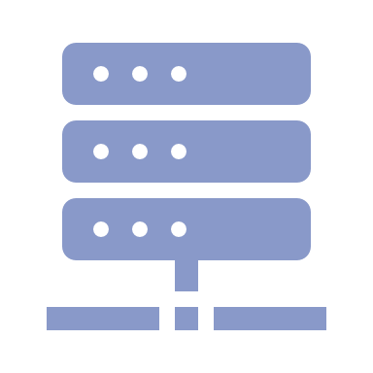
A powerful open-source network traffic analysis tool suite.
https://idaholab.github.io/Malcolm
Streamlined deployment
Suitable for field use (hunt or incident response) or SOC deployment. Runs in Docker or Podman on Linux, macOS and Windows. ISO installer for bare metal installations.
Cloud deployable with Kubernetes. Provides easy-to-use web-based user interfaces.
Industry-standard tools
Uses Arkime, Zeek, and Suricata for traffic analysis; Logstash for parsing and enrichment; OpenSearch or Elasticsearch for indexing; and Dashboards and Arkime for visualization. Also leverages OpenSearch Anomaly Detection, NetBox, Strelka, CyberChef, and other proven tools for analysis of traffic and artifacts.
Expanding control systems visibility
Analyzes more protocols used in operational technology (OT) networks than other open-source or paid solutions. Ongoing development is focused on increasing the quantity and quality of industrial control systems (ICS) traffic.
Dedicated sensor appliance
Hedgehog Linux, a hardened Linux distribution for capturing network traffic and forwarding its metadata to Malcolm.

Slide 14











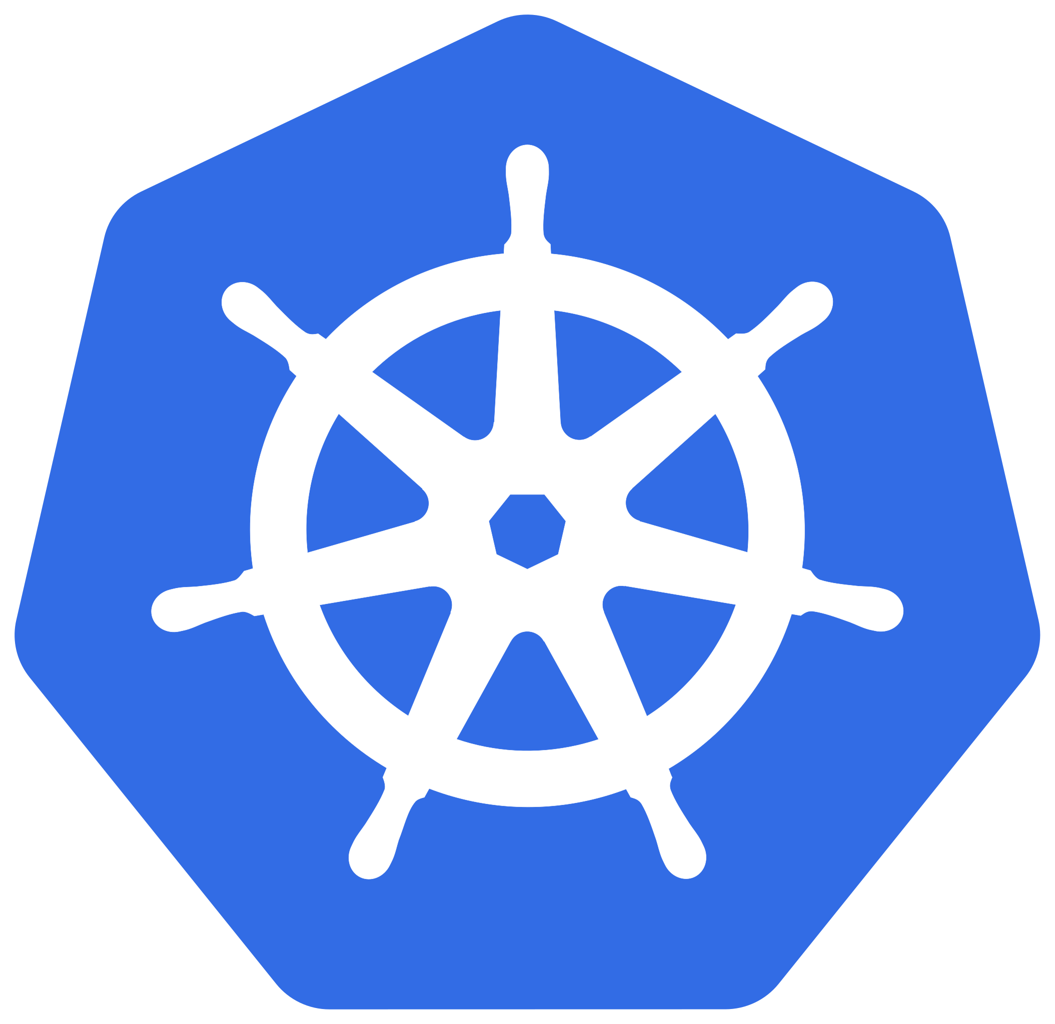
Origins and Milestones
2018.Q2 – Development begins under USBR/CISA work agreement
2018.Q3 to 2019.Q2 – Malcolm field-tested at USBR facilities
2019.Q2 – Initial public release
2021.Q1 – 1k stars on GitHub
2022.Q3 – Malcolm-based simulated engagements begin at INL’s ICS Control Environment Lab Resource (CELR)
2022.Q3 – Malcolm discussed during session of the U.S. House of Representatives Homeland Security Committee
2022.Q4 – NetBox provides asset inventory and interaction analysis
2023.Q1 – Kali releases “Purple” distro bundling Malcolm
2023.Q2 – Cloud deployable with K8s
2024.Q2 – 2k stars on GitHub, community discussions board and new training offerings
2024.Q3 – First public Malcolm user conference, Mal.Con24
2025.Q2 – Keycloak provides SSO and role-based access control
2025.Q4 – Google Threat Intelligence integration
2026.Q1 – Enhanced file scanning with Strelka

Slide 15

What Can It Do For Me?
Get to know your network: Malcolm characterizes traffic by devices and the protocols they use to communicate.
Understand risks and threats: Malcolm identifies active exploits, potential attack vectors, and vulnerable devices and protocols.
Increase visibility: Malcolm highlights inbound, outbound, and internal communications to inform decisions and improve security posture.

Slide 16

What can network traffic reveal about my cybersecurity posture?
A lot!
Malcolm can be used to validate cyber best practices and uncover red flags in network configuration, including:
Proper network segmentation
East-West (cross-segment) and
North-South traffic
Unsecure or outdated protocols
Unexpected protocols
Rogue devices and services
Suspicious file transfers
Sensitive unencrypted information
(e.g., PII, PCII, cleartext credentials)
… and much more
Image credit: kelsercorp.com

Slide 17
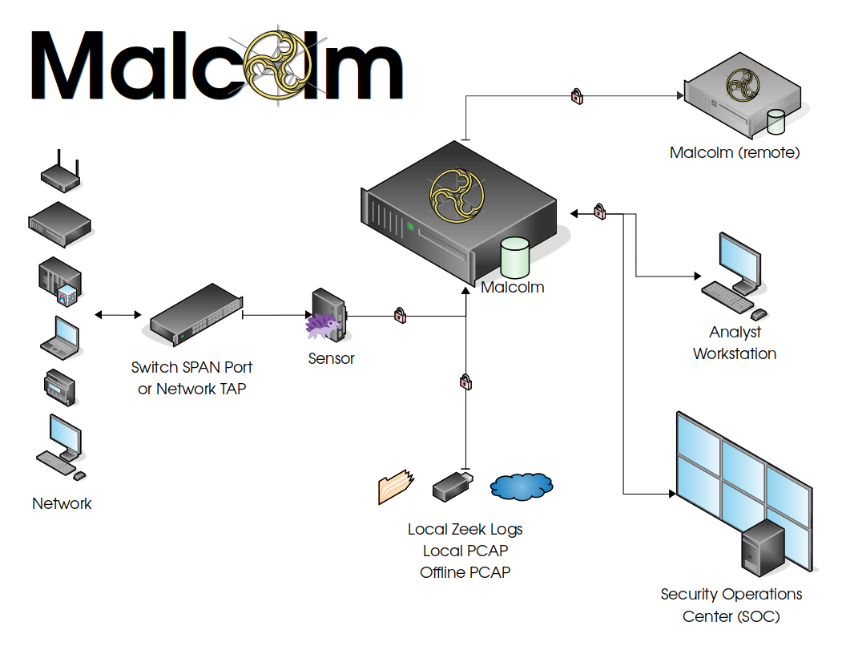

Slide 18
Supported Protocols
https://idaholab.github.io/Malcolm/docs/protocols.html
Internet layer (IP, TCP/IP) ANSI C12.22 Border Gateway Protocol (BGP) Building Automation and Control (BACnet) Bristol Standard Asynchronous Protocol (BSAP) Distributed Computing Environment / Remote Procedure Calls (DCE/RPC) Dynamic Host Configuration Protocol (DHCP) Distributed Network Protocol 3 (DNP3) Domain Name System (DNS) EtherCAT EtherNet/IP / Common Industrial Protocol (CIP) FTP (File Transfer Protocol) Genisys GE Service Request Transport Protocol (SRTP) Google Quick UDP Internet Connections (gQUIC) Highway Addressable Remote Transducer over IP (HART-IP) Hypertext Transfer Protocol (HTTP) IPsec Internet Relay Chat (IRC) Lightweight Directory Access Protocol (LDAP) | Kerberos Modbus MQ Telemetry Transport (MQTT) MySQL NT Lan Manager (NTLM) Network Time Protocol (NTP) Omron Factory Interface Network Service (OMRON FINS) Open Platform Communications Unified Architecture (OPC UA) Binary Open Shortest Path First (OSPF) OpenVPN Oracle PostgreSQL Process Field Net (PROFINET) Redis Remote Authentication Dial-In User Service (RADIUS) Remote Desktop Protocol (RDP) Remote Framebuffer / Virtual Network Computing (RFB/VNC) Remote Operations Controller (ROC) Plus | S7comm / Connection Oriented Transport Protocol (COTP) Secure Shell (SSH) Secure Sockets Layer (SSL) / Transport Layer Security (TLS) Session Initiation Protocol (SIP) Server Message Block (SMB) / Common Internet File System (CIFS) Simple Mail Transfer Protocol (SMTP) Simple Network Management Protocol (SNMP) SOCKS STUN (Session Traversal Utilities for NAT) Synchrophasor (IEEE C37.118) Syslog Tabular Data Stream (TDS) Telnet / remote shell (rsh) / remote login (rlogin) TFTP (Trivial File Transfer Protocol) WebSocket WireGuard various tunnel protocols (e.g., GTP, GRE, Teredo, AYIYA, IP-in-IP, etc.) * Industrial control systems protocols indicated with bold
Notes:
The components comprising Malcolm are industry-standard open source tools, which makes it easy to integrate Malcolm with other solutions in those tools’ respective ecosystems.
Malcolm can interpret network traffic across dozens of application protocols, including several protocols commonly seen in OT networks. Much of Malcolm’s development is dedicated to improving Malcolm’s coverage of protocols used by ICS devices.

Slide 19
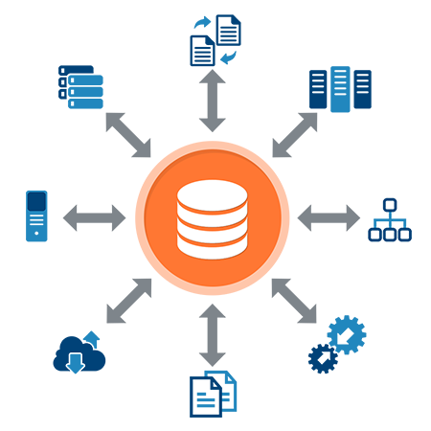




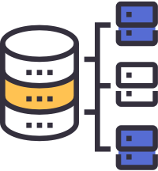
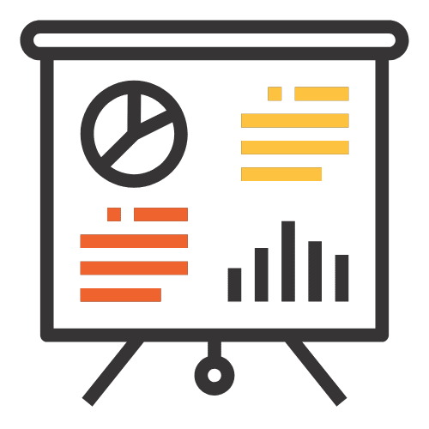
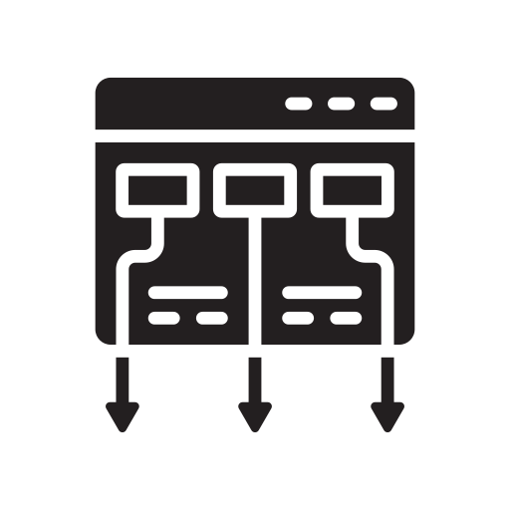
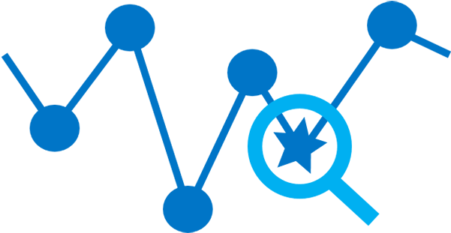













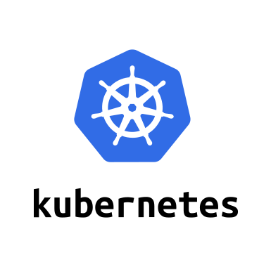




Components
https://idaholab.github.io/Malcolm/docs/components.html
Capture & Analysis
File Scanning
Forwarding & Enrichment
Storage
Anomaly Detection
Visualization
Payload Analysis
Framework
Asset Management
CyberChef
Anomaly Detection Plugin
OpenSearch
Dashboards
OpenSearch
Arkime session PCAP export to
Alerting
Alerting
Alerting Plugin

Slide 20
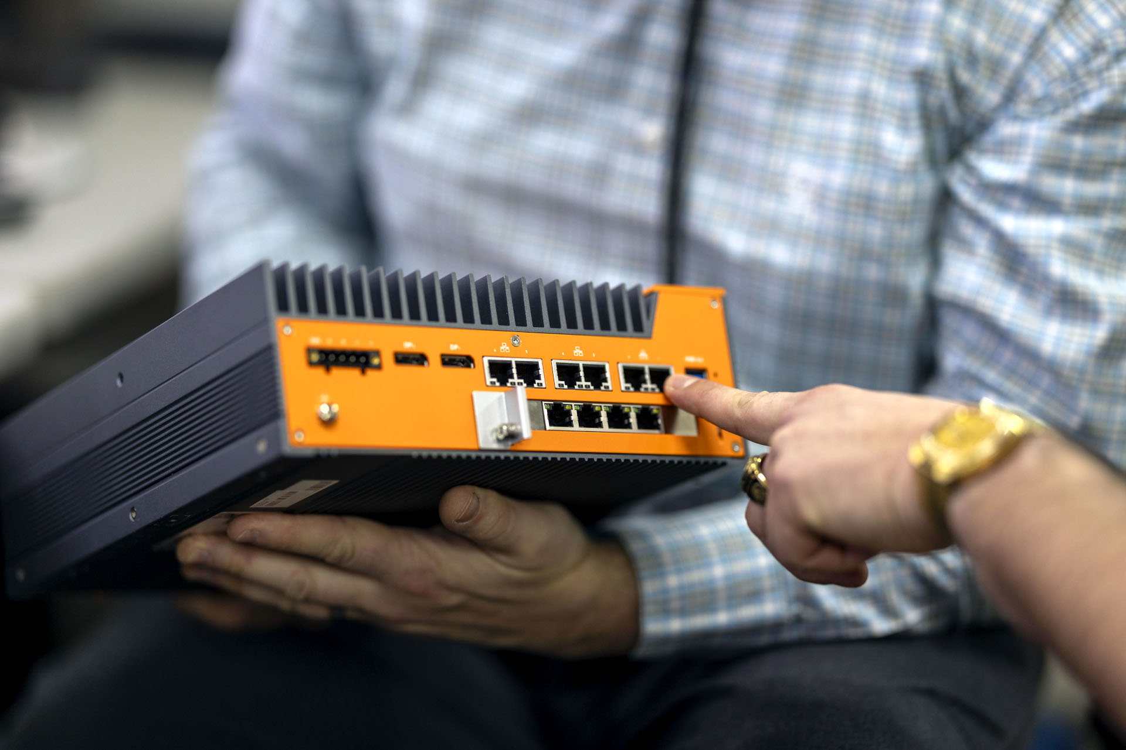

Configuring and Running Malcolm
Runs natively in Docker or Podman,
use ISO installer for VM or bare metal install, or cloud deploy with Kubernetes or Amazon Machine Image (AMI)
Recommended system requirements: 64+GB RAM, 16+ CPU cores, “enough” storage for PCAP and logs
Documentation and source code on GitHub: https://idaholab.github.io/Malcolm
Walkthroughs on YouTube:
“Malcolm Network Traffic Analysis”
Notes:
Malcolm can be installed and run on any system that supports Docker, a containerization platform for software services.
Most modern commodity hardware (including laptops, desktops and servers) are configured with the resources needed to run Malcolm. Available system memory tends to be the most crucial, with 12GB as a bare minimum and 16GB or more recommended.
This presentation does not cover installation and configuration of Malcolm. Please refer to the documentation and examples found at the links provided.

Slide 21
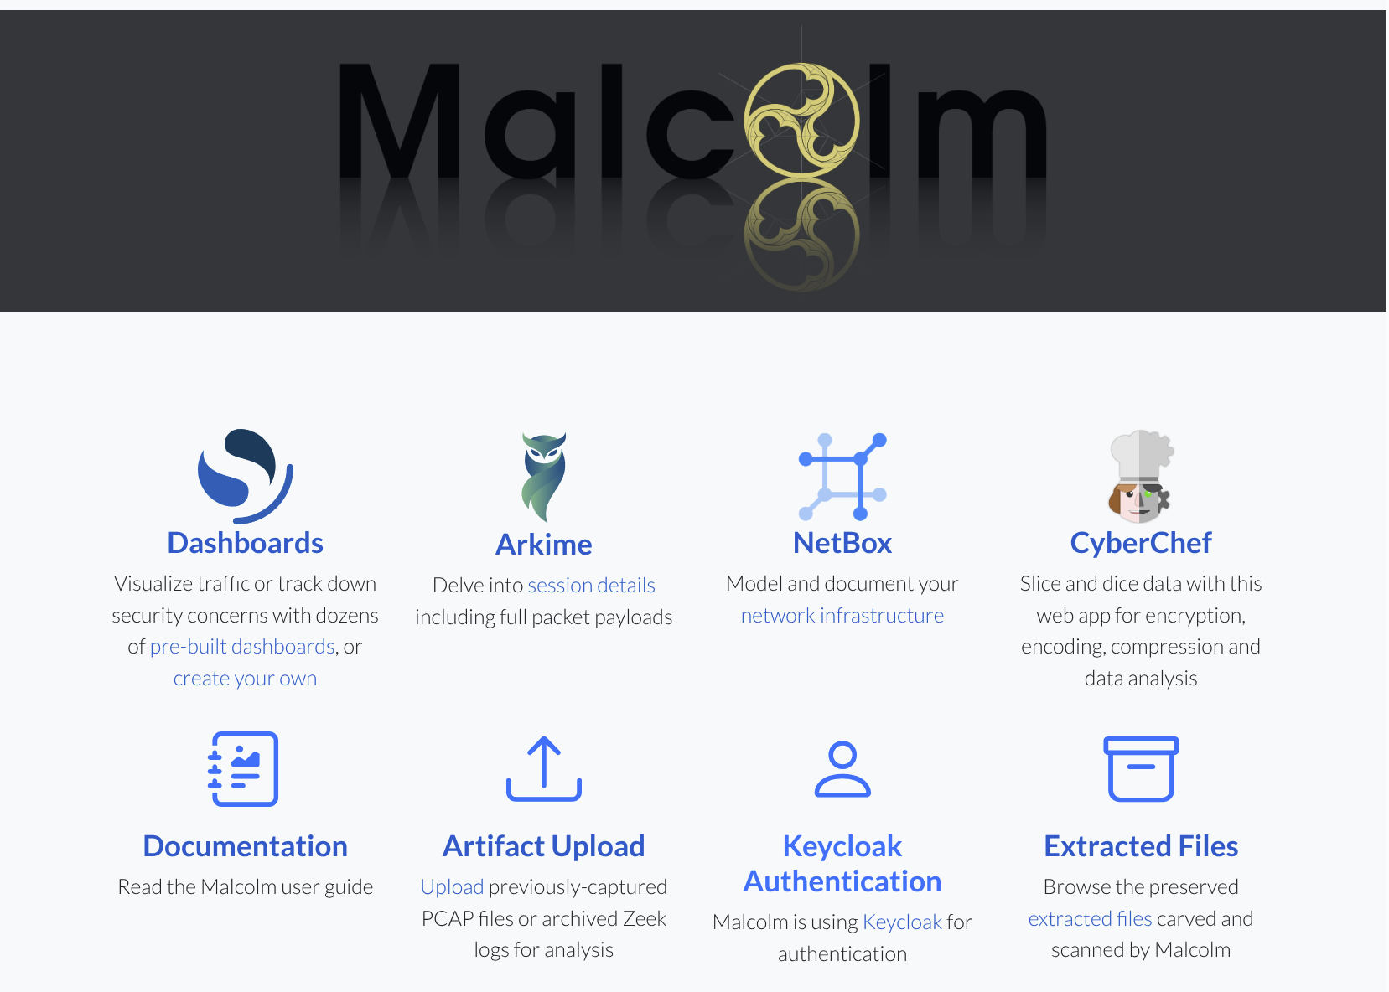

Slide 22
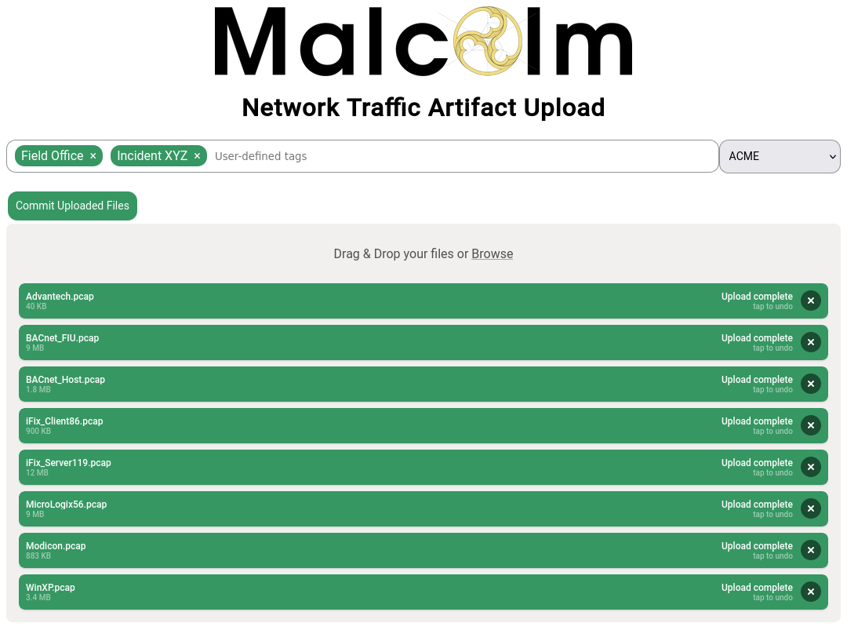
Importing Traffic Captures for Analysis
Upload PCAP files or archived Zeek logs
Specify tags for search
and filter
Specify NetBox site
Notes:
Malcolm must be provided with captured network traffic to interpret, index and present for analysis. While this may be accomplished by dedicated network sensors, more often in assessments PCAP files will have been previously captured and provided for analysis.
PCAP files can be uploaded into Malcolm for processing by accessing /upload on the host on which Malcolm is running.
Prior to starting the upload, “tags” may be added which will allow the data from the PCAP file(s) being uploaded to be searchable using those tags later on. Other behavior relating to how the PCAP file is parsed can also be customized on this page.

Slide 23
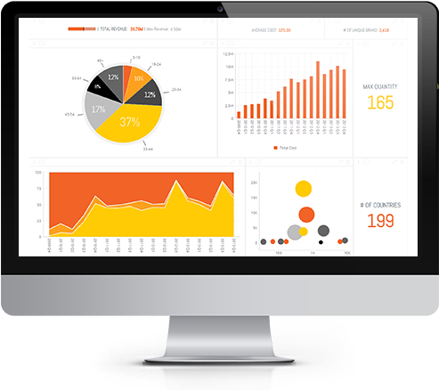




Data Pipeline
https://idaholab.github.io/Malcolm/
Extracted File Scan
OpenSearch
Dashboards
Zeek
Filebeat
Logstash
OpenSearch
Analyst
PCAP
Suricata
Arkime
Viewer
Arkime
capture
Notes:
An uploaded PCAP file goes through several steps on its way to becoming enriched, indexed and user-searchable.
Upon upload, Malcolm generates metadata for the network traffic represented in a PCAP file using both Zeek and moloch-capture.
Arkime’s moloch-capture aggregates metadata for a particular network connection into what it calls a “session” record, which written to OpenSearch for indexing.
Zeek generates several log files, primarily broken out by application protocol, which contains metadata similar to that generated by moloch-capture.
Malcolm can also leverage Zeek’s ability to “carve” out files transferred over the network. These files can be scanned (for example, by an antivirus tool) or preserved for analysis with external tools.
The Zeek logs are forwarded by Filebeat to Logstash for further enrichment, normalized to the same field schema as the corresponding Arkime sessions and then indexed into OpenSearch.
Once ingested by OpenSearch, Malcolm provides two interfaces for visualizing network traffic: Dashboards and Arkime Viewer.

Slide 24
Data Pipeline
https://idaholab.github.io/Malcolm/
Traffic is collected passively by sensor device running Hedgehog Linux
Logs are securely forwarded to Malcolm
Logs are enriched and stored in OpenSearch
Machine learning algorithms identify anomalies
Alerts are sent over email, webhooks, etc.
Traffic is visualized in OpenSearch Dashboards and Arkime Viewer
  Zeek, Arkime, and Suricata generate metadata about network communications
  Full PCAP is stored locally on the sensor
  Files transfers are detected, and the files scanned for threats
  PCAP may also be uploaded to or captured by Malcolm without requiring a dedicated sensor
  Communications between the sensor and aggregator are TLS-encrypted
  Sensor data including resource utilization, syslog, audit logs, temperatures, and more may also be forwarded
  Other third-party logs (e.g., Windows event logs, server host logs, etc.) may be shipped using Fluent Bit or Beats
  Lookups are performed for GeoIP, ASN, MAC-to-vendor, community ID, domain name entropy, etc.
  Network events are normalized across protocols and data sources
  Best-guess techniques are applied to identify obscure OT traffic
  Enriched metadata may be forwarded to higher-tiered Malcolm instance
  Default detectors are provided for action and result, flow size, and MIME types of file transfers
  Custom detectors may be created for any aspect of any supported protocol
  Alerts may be triggered by exceeded thresholds, anomalies detected, custom queries, etc.
  Dozens of custom dashboards are provided for all supported protocols
  PCAP payloads are retrieved from sensor on demand
  Create custom visualizations via drag-and-drop interface
  Malcolm authenticates users from its own list, with SSO via Keycloak, or using Active Directory / LDAP

Slide 25

Log Enrichment
Tagging
Reverse DNS
GeoIP and ASN Lookups
Domain Name Entropy Calculation
Network Direction
Severity Scoring
Hardware Vendor OUI Lookups

Slide 26
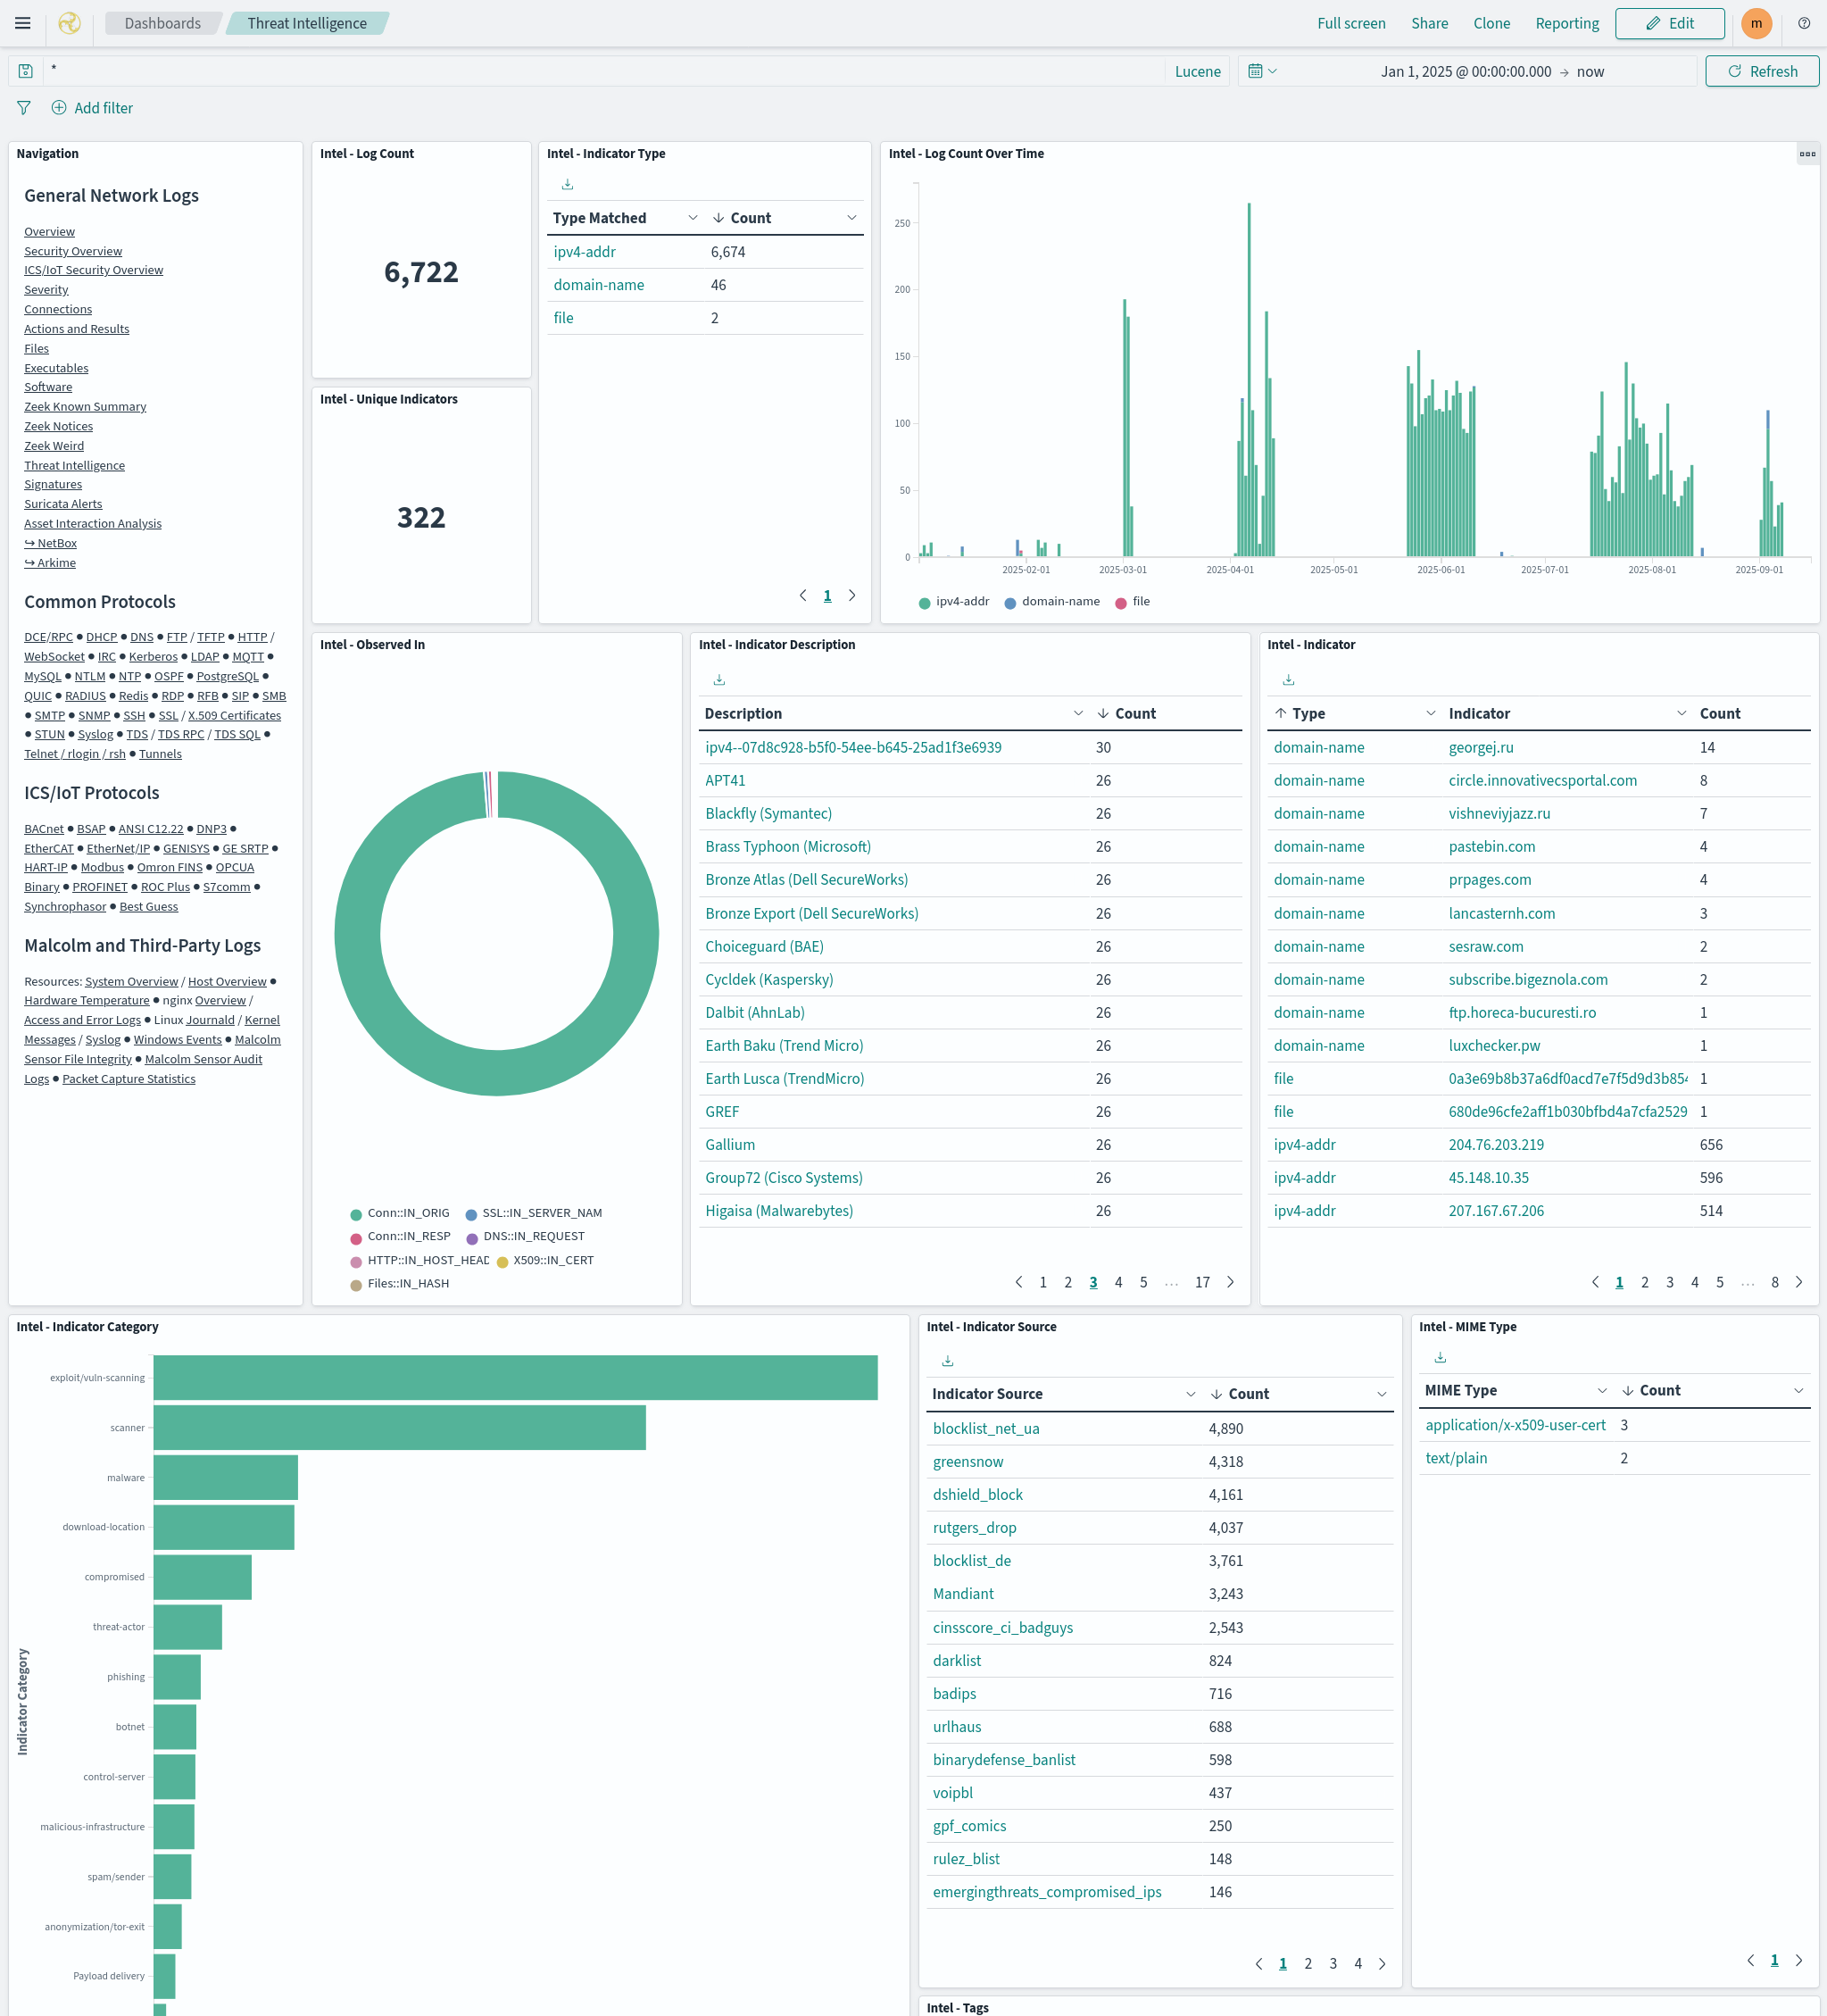

Dashboards
Front end for Zeek logs and Suricata alerts
Prebuilt visualizations for all supported protocols
WYSIWYG editors to create custom visualizations and dashboards
Drill down from high-level trends to specific items of interest
Notes:
Dashboards is one of Malcolm’s two user interfaces for visualizing log data.
Where Dashboards really shines is in providing intuitive interactive representations of log data that simplify the process of recognizing and narrowing in on important network events: starting from a high-level overview and being able to quickly “drill-down” to the traffic of an individual host or connection of interest.
Malcolm comes with dozens of prebuilt visualizations specifically for data ingested from Zeek logs. Its dashboards fall into two categories: overview dashboards and protocol-specific dashboards. We’ll review some of these in a moment.
Aside from its prebuilt offerings, Dashboards provides an easy drag-and-drop WYSIWYG editor for creating new visualizations on the fly.

Slide 27
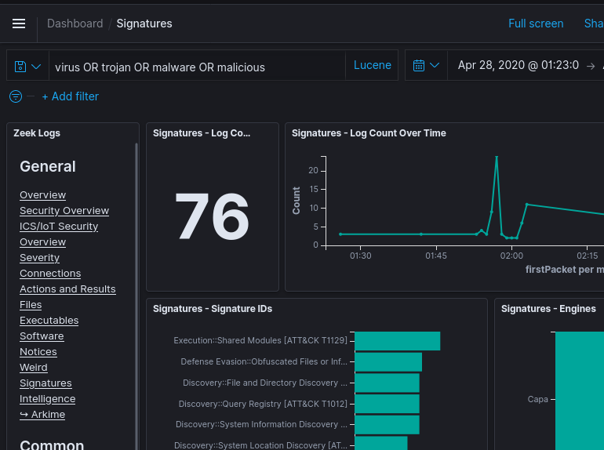
Dashboards Filters and Search
Time filter: define search time frame
Query bar: write queries in Lucene syntax or DQL (Dashboards Query Language)
Filter bar: define filters using a UI
  Pin filters as you move across dashboards
Save queries and filters for reuse
Notes:
The first step to analyzing network traffic with Dashboards is to identify the time range of interest. This can be done using the time filter controls in the upper right-hand corner of the interface.
The query bar allows you to specify search constraints, using Lucene query syntax. Modifying the contents of this bar and hitting Enter or clicking the Search icon to the right will run the search and update the results displayed. The “Search Syntax Comparison” table in a few slides gives some examples of the syntax that can be used in the query bar.
The filter bar is another way of specifying search constraints, although it provides more of a GUI-type interface to do so. In most cases there’s not really a meaningful distinction between putting query terms in via the query bar vs. the filter bar, although using the filter bar does allow you to more easily pin filters across different dashboards and is somewhat more intuitive. Filters may also be populated by clicking on values in charts and graphs and choosing the magnifying glass icon with either the plus sign (+) or minus sign (-) to restrict to or exclude that value from the result set.
A future release of Dashboards will merge them into a single search component.

Slide 28
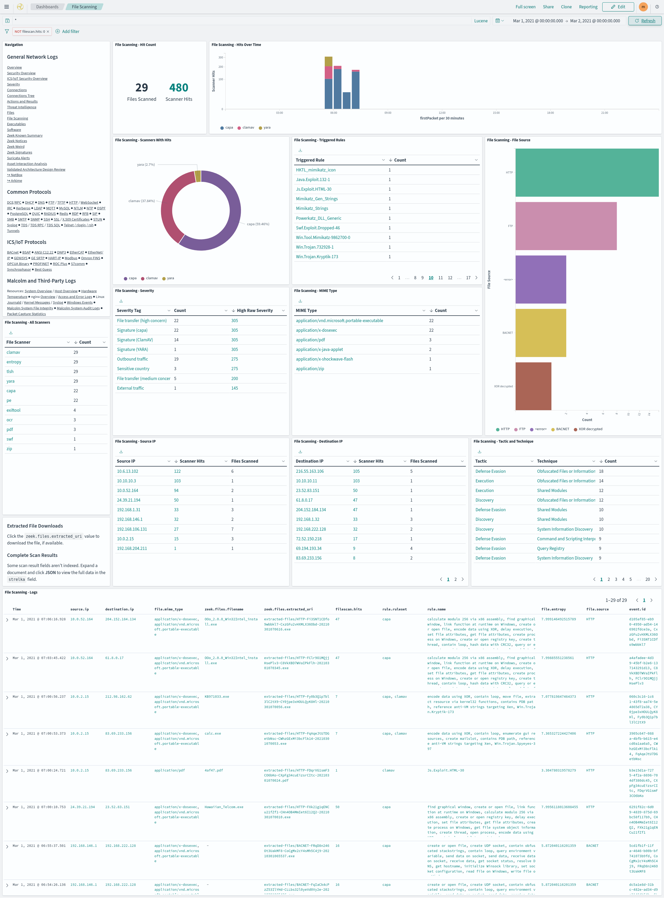
Overview Dashboards
High-level view of trends, sessions and events
Populated from logs across all protocols
Good jumping-off place for investigation
Notes:
The dashboards under the General section of Malcolm’s Dashboards navigation panel provide a high-level overview of network traffic from across all of the logs generated by Zeek. These dashboards are a good jumping-off point for investigation when trying to get a “feel” for the network and the application protocols used by the hosts that comprise it.

Slide 29
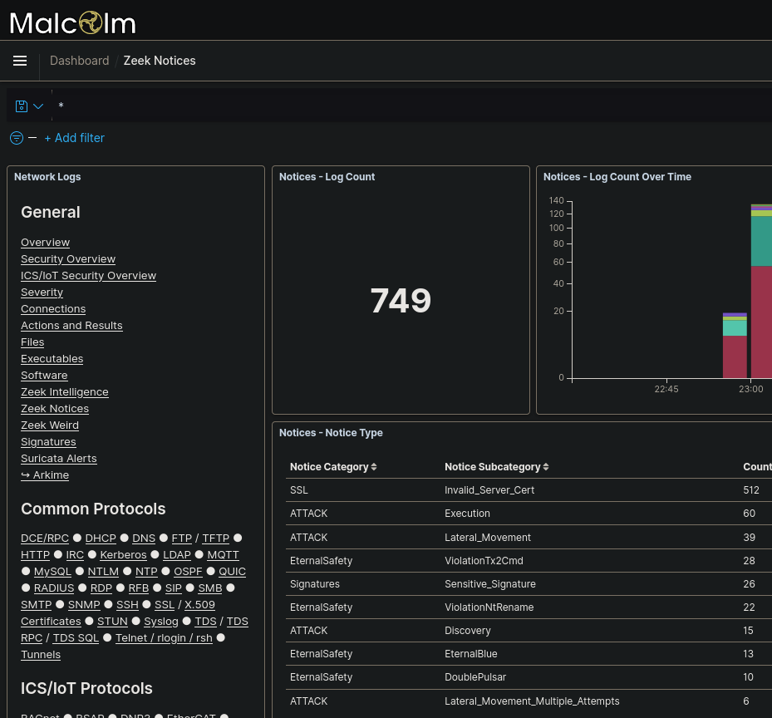
Zeek Notices
Zeek notices are things that are odd or potentially bad
In addition to Zeek’s defaults, Malcolm raises notices for recent critical vulnerabilities and attack techniques
Notes:
As discussed earlier, Zeek notices are the tool’s way of raising some event to the forefront of an analyst’s attention. To quote the Zeek notice framework’s documentation:
Zeek ships with a large number of policy scripts which perform a wide variety of analyses. Most of these scripts monitor for activity which might be of interest for the user. However, none of these scripts determines the importance of what it finds itself. Instead, the scripts only flag situations as potentially interesting, leaving it to the local configuration to define which of them are in fact actionable. This decoupling of detection and reporting allows Zeek to address the different needs that sites have. Definitions of what constitutes an attack or even a compromise differ quite a bit between environments, and activity deemed malicious at one site might be fully acceptable at another. (https://docs.zeek.org/en/current/frameworks/notice.html)
Zeek currently implements about 50 notices by default, and Malcolm adds several more, ranging from brute-force SSH login attempts to SQL injection attacks to expired SSL certificates and more. A list of Zeek’s built-in notices can be found at https://docs.zeek.org/en/stable/zeek-noticeindex.html.
The third-party Zeek plugins used by Malcolm are listed in the Malcolm README at https://github.com/idaholab/Malcolm#Components. They include, but are not limited to, notices generated for:
cleartext passwords detected in in HTTP POST requests
noncompliant HTTP requests (like those used for smuggling)
XOR-obfuscated file transfers
Behavior/techniques categorized according to the MITRE ATT&CK framework
Various other CVEs and vulnerabilities, including
Bad Neighbor (CVE-2020-16898)
CallStranger (CVE-2020-12695)
SIGRed (CVE-2020-1350)
Zerologon (CVE-2020-1472)
CVE-2020-0601 ECC certificate validation
CVE-2020-13777 GnuTLS unencrypted session ticket detection
the Eternal* family of SMBv1 Windows exploits (EternalBlue, EternalSynergy, EternalRomance, DoublePulsar and other SMBv1 exploits)
Ripple20
The developers of Malcolm endeavor to stay abreast of developments in the threat landscape and, when possible, release updates adding new Zeek detection scripts for vulnerabilities and exploits as they are discovered by cybersecurity researchers.

Slide 30
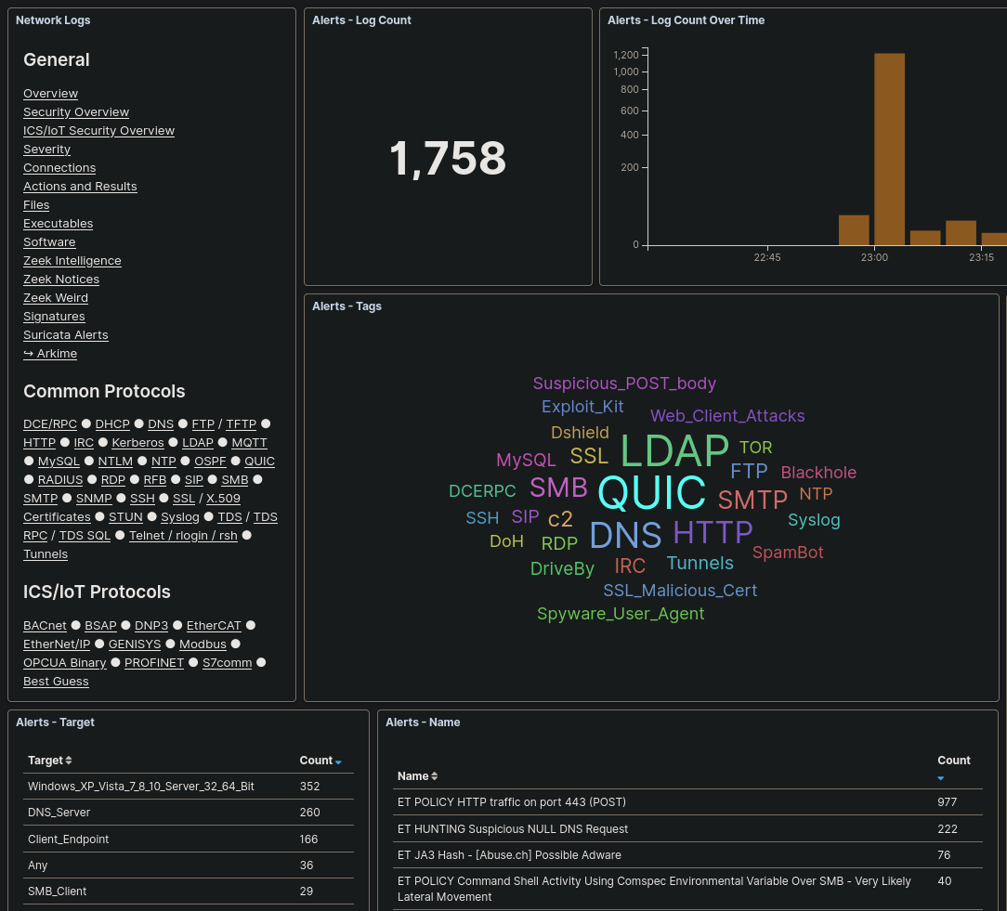
Suricata Alerts
Protocol-aware Suricata signatures generate alerts for suspect traffic
Use the default Emerging Threats Open ruleset or custom signatures from other sources

Slide 31
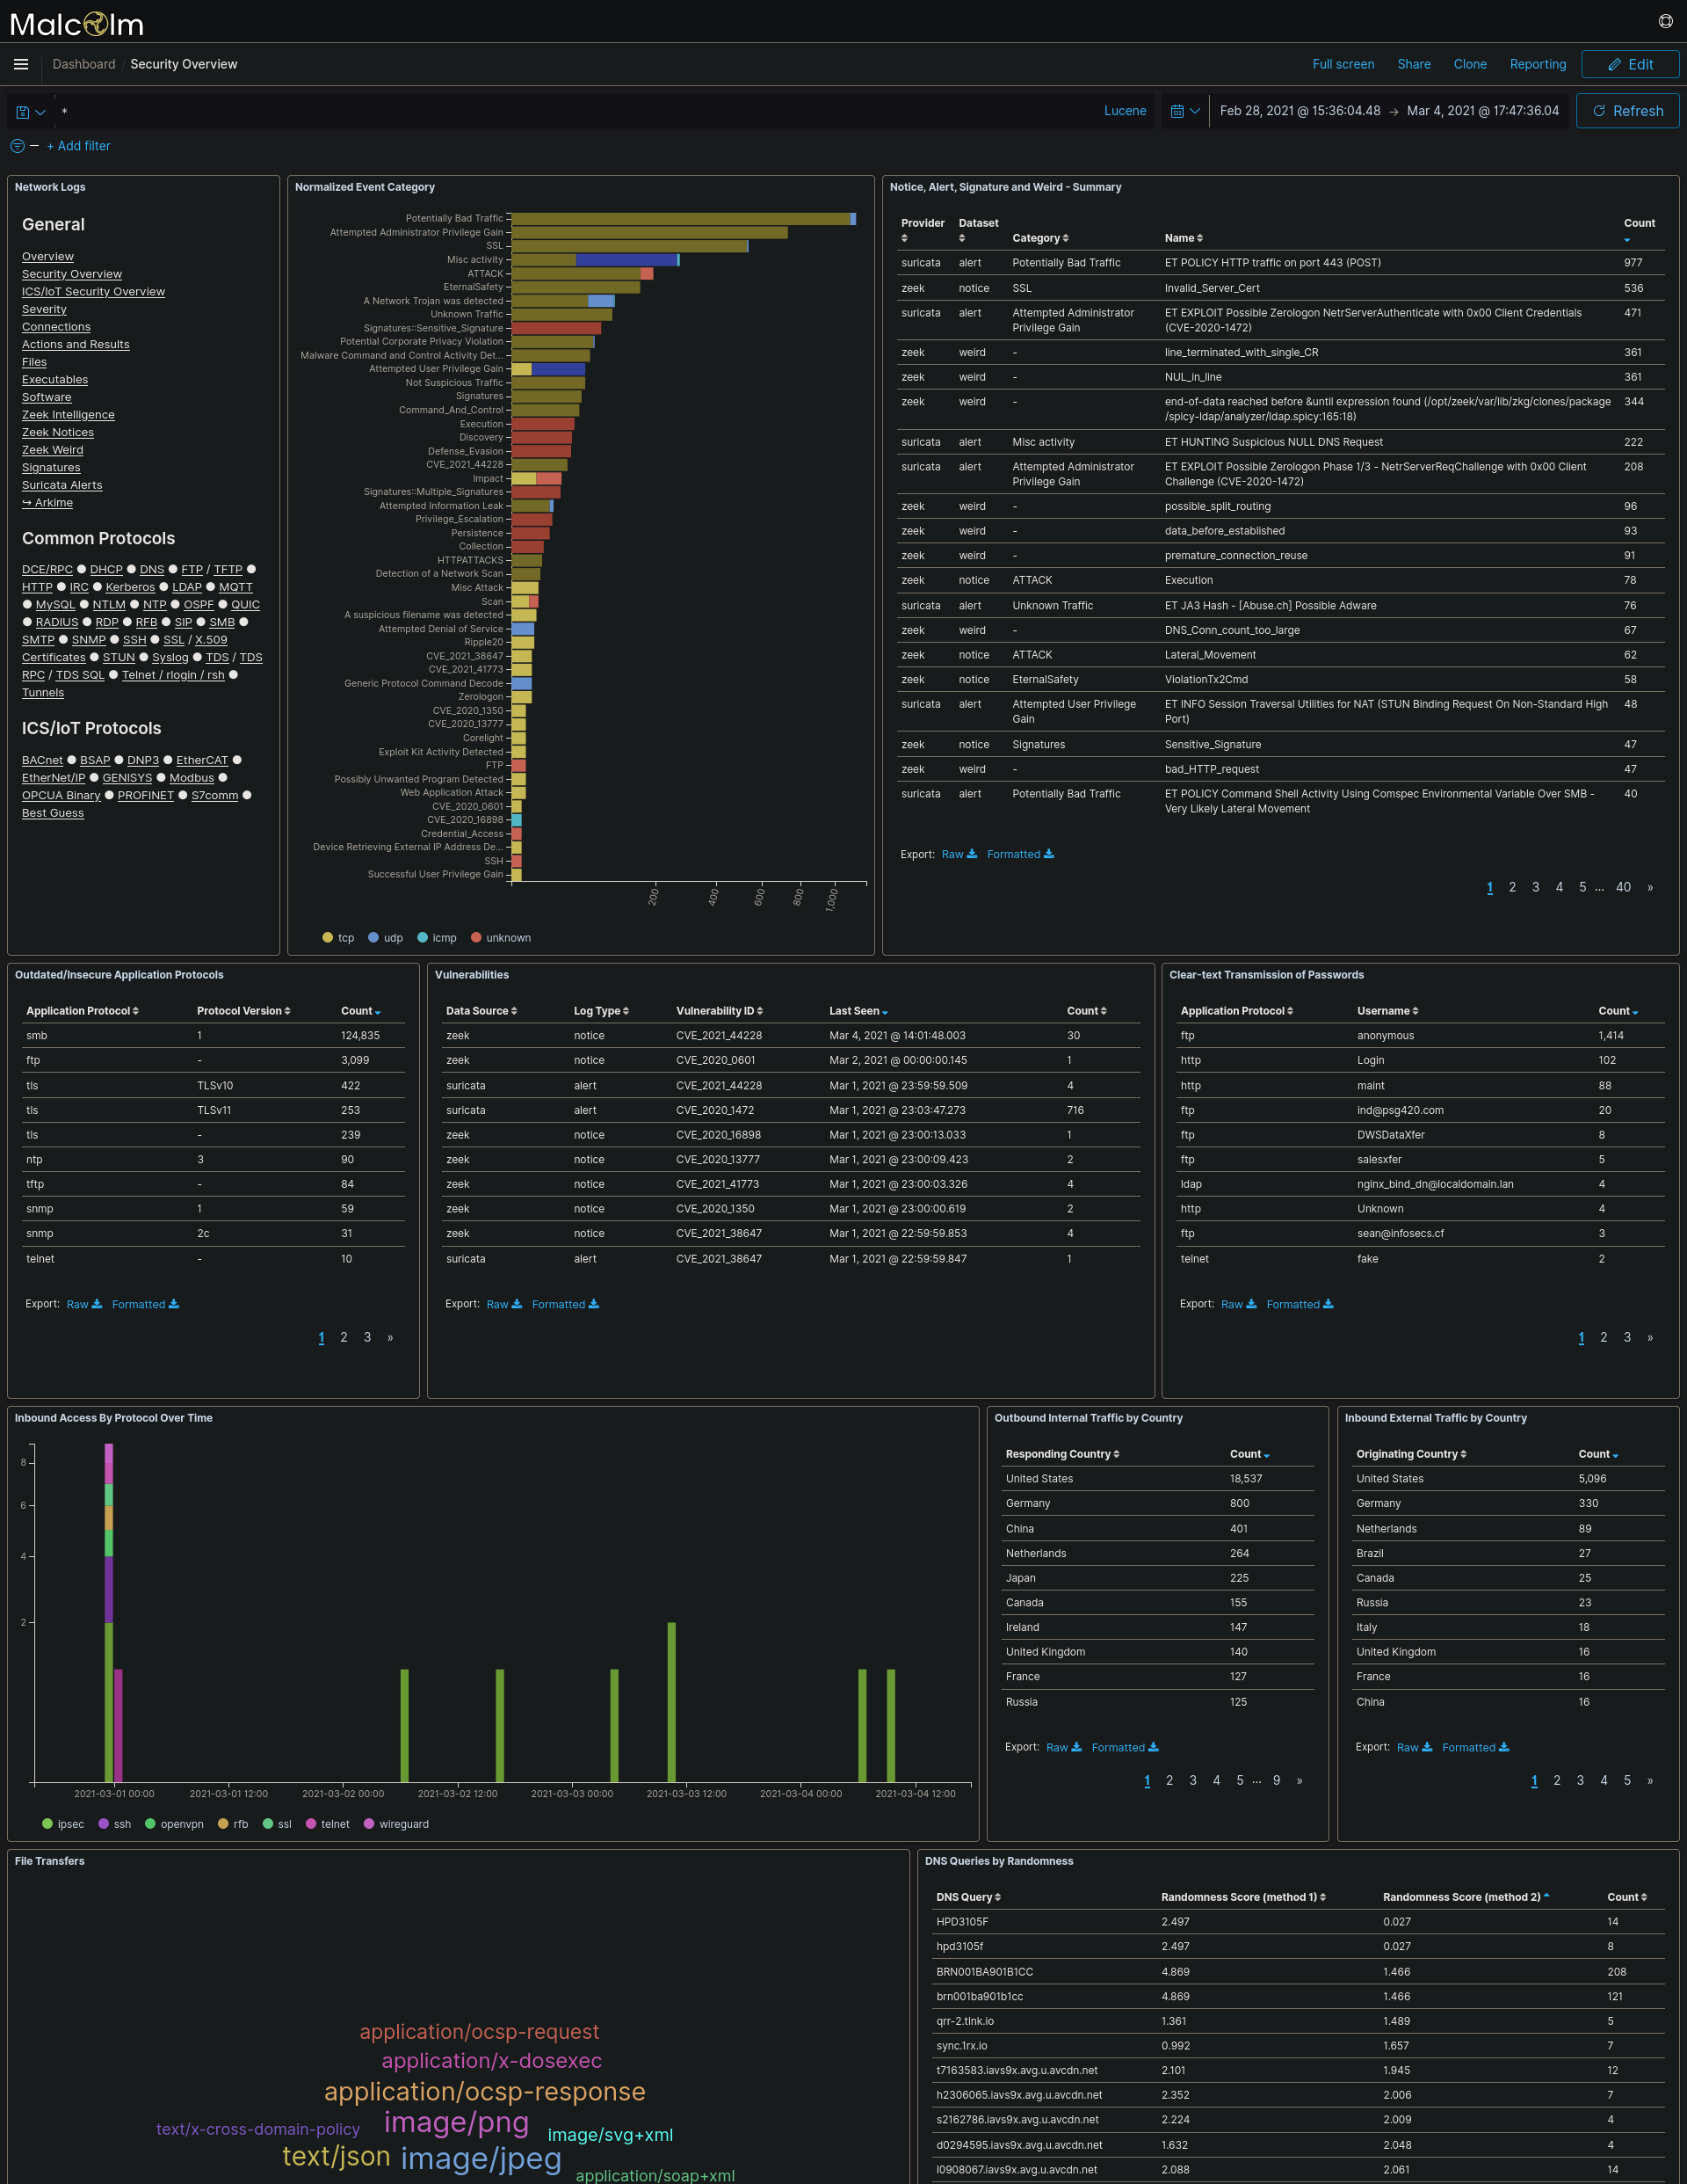
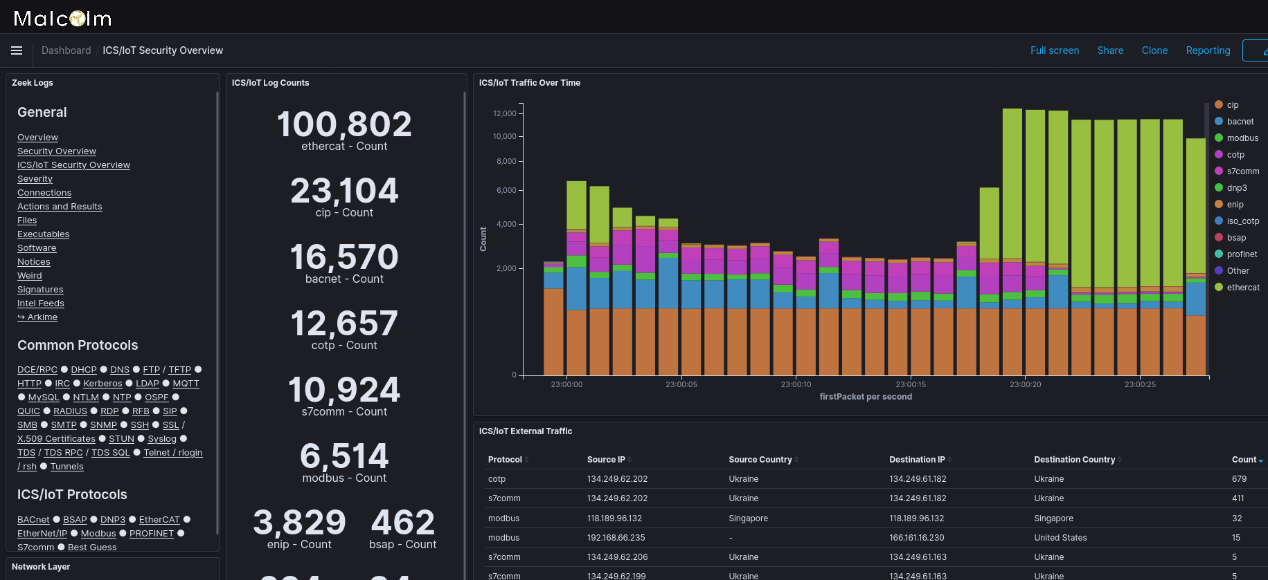
Security & ICS/IoT Security Overviews
Notes:
The Security Overview and ICS/IoT Security Overview dashboards highlight events that may be of particular interest from a security standpoint, including Zeek notices, signatures triggered from file scans, clear-text transmission of passwords, outdated or insecure versions of application protocols, traffic originating from or directed to public IP addresses, file transfers and more.
These dashboards are a good place to start when looking for indicators of compromise or vulnerabilities in network traffic.

Slide 32
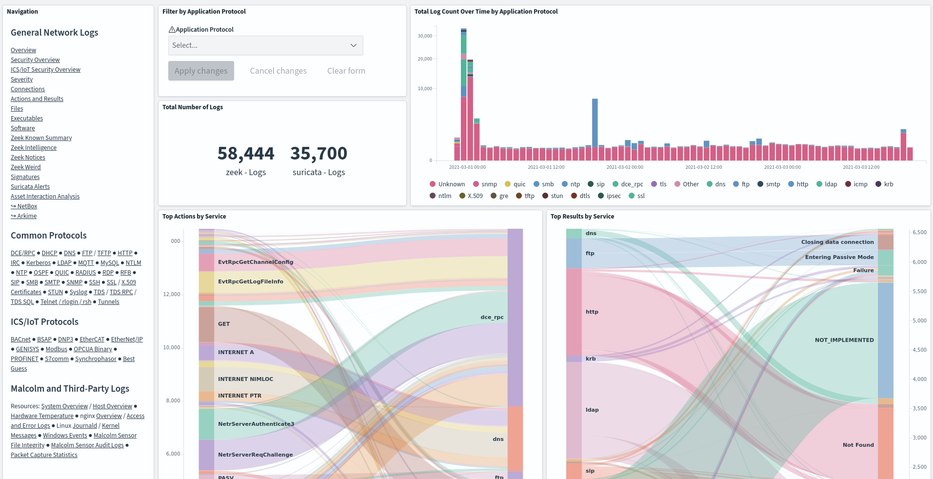
Actions and Results
Malcolm normalizes “action” (e.g., write, read, create file, logon, logoff, etc.) and “result” (e.g., success, failure, access denied, not found) across protocols
Notes:
Where possible, Malcolm correlates common fields from across different protocols to allow you to view one device’s or application’s network traffic in the context of the other traffic occurring around it.
For example, multiple failed HTTP authentication attempts, followed by a successful authenticated HTTP POST operation followed by successful reads and writes to a file server could indicate that a foothold was obtained in an HTTP server that allowed an adversary to pivot to another service in the network.
A good example of this is the Actions and Results dashboard, in which actions (such as “a file was written,” “a logon was attempted,” “a web page was requested”) and “results” (“success,” “access denied,” “page not found”) can be inspected together regardless of protocol.

Slide 33
Protocol Dashboards
Highlight application-specific fields of interest
Grouped by common IT protocols and ICS/IoT protocols
Dashboards also included for host logs (Windows event logs, syslog, Journald messages, etc.) and other data sources (system resource utilization, packet capture statistics, sensor temperature, etc.)
Notes:
In addition to the overview dashboards, Malcolm provides dozens of dashboards tailored to specific application protocols, including protocols commonly used in industrial control systems networks.

Slide 34
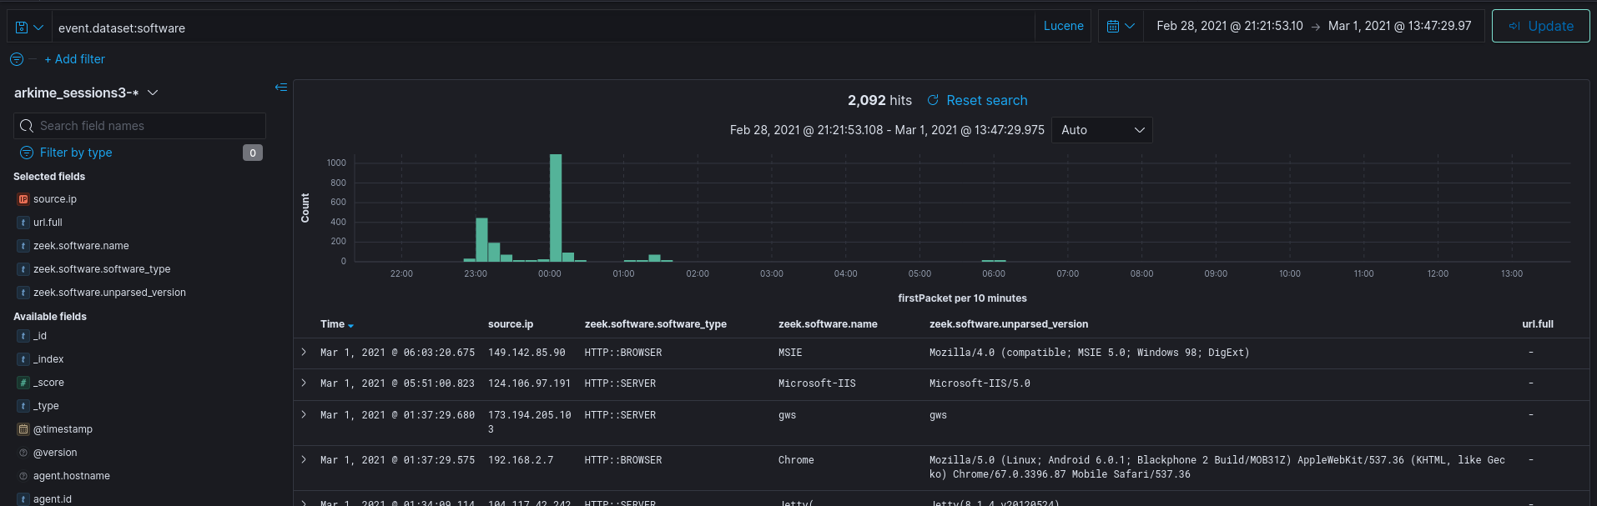
Discover
Field-level details of logs matching filter criteria
Create and view saved searches and column configurations
View other events just before and after an event
Notes:
The Discover view enables you to view events on a record-by-record basis, similar to a session record in Arkime, which we’ll discuss in a moment, or to an individual line from a Zeek log.
The data table in the Discover view can be customized to display only the fields relevant to the traffic you’re interested in: for example, a “play-by-play” of an HTTP session could be reviewed by filtering on event.dataset:http, sorting by Time and including the following fields in the table:
source.ip
zeek_http.user_agent
zeek_http.referrer
destination.ip
zeek_http.host
zeek_http.uri
zeek_http.status_msg
This configuration could be stored as a saved search and returned to for future investigation.

Slide 35
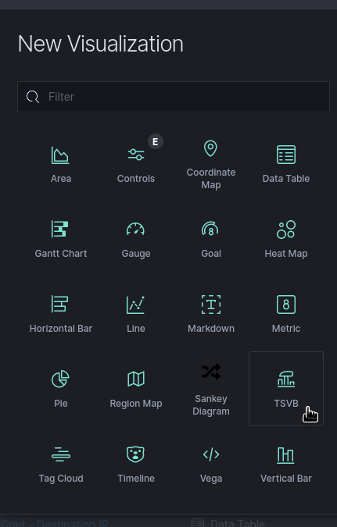
Custom Visualizations
Create new visualizations from scratch or based on existing charts or dashboards
Notes:
The visualizations page allows you to view and manage visualization components, which are like “graphical building blocks” to be used in dashboards. Dashboards includes many different kinds of charts, tables, and maps for displaying your data.

Slide 36
Exercises: Cyberville PCAP
Cyberville PCAP from “The Cyberville Migrogrid CTF”, DISC – SANS ICS Virtual Conference, spring 2020
  https://www.sans.org/media/DISC-event-details.pdf
  https://www.sans.org/webcasts/114285
https://malcolm.fyi/examples/Cyberville.pcap
Scenario courtesy SANS and Dragos
Used with permission
Notes:
Network traffic analysis is all about getting to the “important stuff” as quickly as possible.
There are many open source and proprietary tools available for analyzing raw packet capture (PCAP) files: WireShark, Network Miner, GrassMarlin, etc.
Analyzing PCAP sets that are large (or from complex networks) with many of these tools is difficult, as often they at best struggle and at worst outright fail to handle packet captures larger than a few hundred megabytes.
Today we’re going to talk about the open source network traffic analysis tool suite Malcolm, developed at the Idaho National Lab with support from the US Department of Homeland Security. You may be familiar with some or all of the open source tools which make up Malcolm: all are already available and in general use. What Malcolm provides a is a framework of interconnectivity which makes it greater than the sum of its parts, streamlining network traffic analysis and bringing that “important stuff” to the foreground as painlessly as possible.
This morning we’re going to talk about using Malcolm to gain insight into both link-layer and application-layer network traffic.

Slide 37
Exercise: Examine PCAP data in Dashboards
What common (IT) protocols were observed? What about ICS (OT) protocols?
What types of files were transmitted, and how?
Were any HTTP user agents observed that may be of concern?
How many EtherNet/IP “Stop” operations were observed? What about the “Reset” operation? In which network segment(s) were the operations observed?
Were any credentials passed in clear text? If so, identify the username(s) and/or password(s).
What are some other potential red flags found in Dashboards that may warrant investigation?
Create a custom table visualization to highlight cross-segment traffic. Fields of interest may include IPs, host and segment names and protocols.
Notes:
As mentioned, Arkime’s ability to tie a session record back to its original packet(s) is one of its greatest strengths. Details for individual sessions/logs can be expanded by clicking the plus ➕ icon on the left of each row. For Arkime session records, an additional Packets section will be visible underneath the metadata sections.
When the details of a session of this type are expanded, Arkime will read the packet(s) comprising the session for display here. Various controls can be used to adjust how the packet is displayed (enabling natural decoding and enabling Show Images & Files may produce visually pleasing results), and other options (including PCAP download, carving images and files, applying decoding filters, and examining payloads in CyberChef) are available.

Slide 38
Search Syntax Comparison
 | Arkime | Dashboards (Lucene) | Dashboards (DQL)
Field exists | event.dataset == EXISTS! | _exists_:event.dataset | event.dataset:*
Field does not exist | event.dataset != EXISTS! | NOT _exists_:event.dataset | NOT event.dataset:*
Field matches a value | port.dst == 22 | destination.port:22 | destination.port:22
Field does not match a value | port.dst != 22 | NOT destination.port:22 | NOT destination.port:22
Field matches at least one of a list of values | tags == [external_source, external_destination] | tags:(external_source OR external_destination) | tags:(external_source or external_destination)
Field range (inclusive) | http.statuscode >= 200 && http.statuscode <= 300 | http.statuscode:[200 TO 300] | http.statuscode >= 200 and http.statuscode <= 300
Notes:
As Malcolm is a collection of open source tools, an analyst must be aware of and become familiar with the query languages understood by its varied components.
This table compares common types of query strings across Arkime, Lucene and Dashboards Query Language syntaxes.

Slide 39
Search Syntax Comparison (cont.)
 | Arkime | Dashboards (Lucene) | Dashboards (DQL)
Field range (exclusive) | http.statuscode > 200 && http.statuscode < 300 | http.statuscode:{200 TO 300} | http.statuscode > 200 and http.statuscode < 300
Field range (mixed exclusivity) | http.statuscode >= 200 && http.statuscode < 300 | http.statuscode:[200 TO 300} | http.statuscode >= 200 and http.statuscode < 300
Match all search terms (AND) | (tags == [external_source, external_destination]) && (http.statuscode == 401) | tags:(external_source OR external_destination) AND http.statuscode:401 | tags:(external_source or external_destination) and http.statuscode:401
Match any search terms (OR) | (zeek_ftp.password == EXISTS!) || (zeek_http.password == EXISTS!) || (zeek.user == "anonymous") | _exists_:zeek_ftp.password OR _exists_:zeek_http.password OR zeek.user:"anonymous" | zeek_ftp.password:* or zeek_http.password:* or zeek.user:"anonymous"

Slide 40
Search Syntax Comparison (cont.)
 | Arkime | Dashboards (Lucene) | Dashboards (DQL)
Global string search (anywhere in the document) | all Arkime search expressions are field-based | microsoft | microsoft
Wildcards | host.dns == "*micro?oft*" (? for single character, * for any characters) | dns.host:*micro?oft* (? for single character, * for any characters) | dns.host:*micro*ft* (* for any characters)
Regex | host.http == /.*www\.f.*k\.com.*/ | zeek_http.host: /.*www\.f.*k\.com.*/ | Dashboards Query Language does not currently support regex
IPv4 values | ip == 0.0.0.0/0 | source.ip:"0.0.0.0/0" OR destination.ip:"0.0.0.0/0" | source.ip:"0.0.0.0/0" OR destination.ip:"0.0.0.0/0"
IPv6 values | (ip.src == EXISTS! || ip.dst == EXISTS!) && (ip != 0.0.0.0/0) | (_exists_:source.ip AND NOT source.ip:"0.0.0.0/0") OR (_exists_:destination.ip AND NOT destination.ip:"0.0.0.0/0") | (source.ip:* and not source.ip:"0.0.0.0/0") or (destination.ip:* and not destination.ip:"0.0.0.0/0")

Slide 41
Search Syntax Comparison (cont.)
 | Arkime | Dashboards (Lucene) | Dashboards (DQL)
GeoIP information available | country == EXISTS! | _exists_:destination.geo OR _exists_:source.geo | destination.geo:* or source.geo:*
Log type | event.dataset == notice | event.dataset:notice | event.dataset:notice
IP CIDR Subnets | ip.src == 172.16.0.0/12 | source.ip:"172.16.0.0/12" | source.ip:"172.16.0.0/12"
Search time frame | Use Arkime time bounding controls under the search bar | Use Dashboards time range controls in the upper right-hand corner | Use Dashboards time range controls in the upper right-hand corner
GeoIP information available | country == EXISTS! | _exists_:destination.geo OR _exists_:source.geo | destination.geo:* or source.geo:*

Slide 42
Front end for enriched Zeek logs, Suricata alerts and Arkime sessions
  Malcolm’s custom Arkime data source adds full support for Zeek and Suricata logs to Arkime, including ICS protocols
Filter by data source (Zeek, Suricata or Arkime); or, view together
“Wireshark at scale”: full PCAP availability for
  viewing packet payload
  exporting filtered and joined PCAP sessions
  running deep-packet searches
Notes:
While Dashboards is great for “at-a-glance” views and for creating custom visualizations, Arkime (formerly Moloch) provides another interface for examining network traffic that may be better suited to in-depth analysis and network forensics.
Earlier when we talked about the Malcolm PCAP processing pipeline, we mentioned two metadata representations of the same network traffic: the logs generated by Zeek and the session records generated by Arkime’s moloch-capture. While Malcolm’s Dashboards dashboards are focused on the Zeek logs, its instance of Arkime can be used to view both Zeek logs and Arkime sessions together in the same interface.
Another strength of Arkime is its ability to tie the session metadata back to the original packets’ payloads, allowing you to view, search and export the data deeper in the PCAP that may not be referenced in the metadata. Arkime is able to efficiently deal with very large PCAP file sets, something that Wireshark struggles to do.

Slide 43
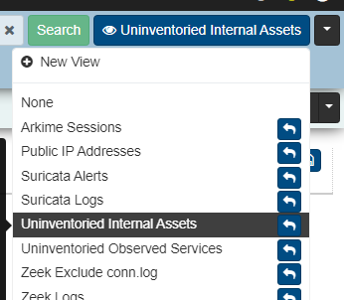
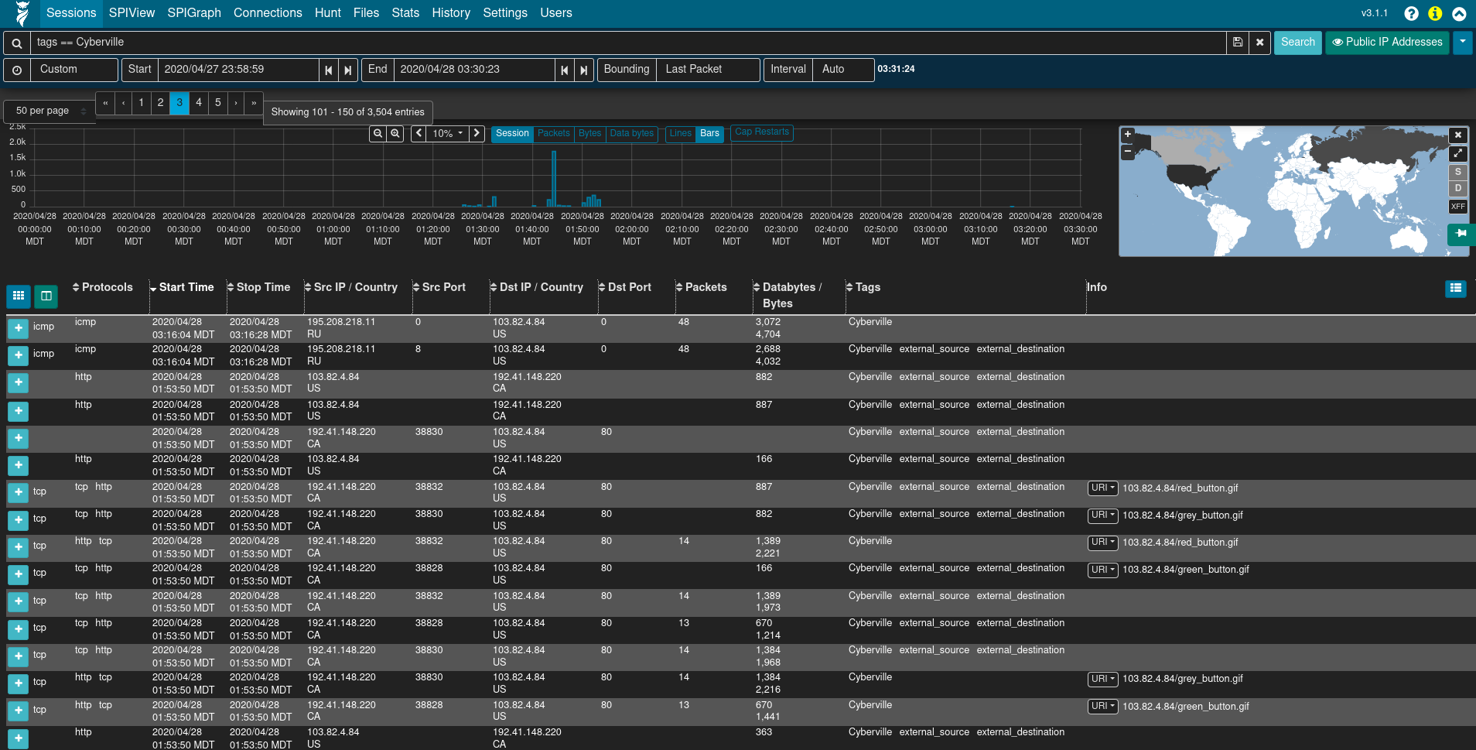
Arkime Filters and Search
Time filter: define search time frame
Map filter: restrict results to geolocation
Query bar: write queries in Arkime syntax
Views: overlay previously-specified filters on current search
Notes:
The Arkime interface has various controls for applying time, geographic and field value filters to narrow the set of matching sessions.
In addition, Arkime’s views (indicated by the eyeball 👁 icon) allow overlaying additional previously-specified filters onto the current sessions filters. For convenience, Malcolm provides several Arkime preconfigured views including several on the event.dataset field.

Slide 44
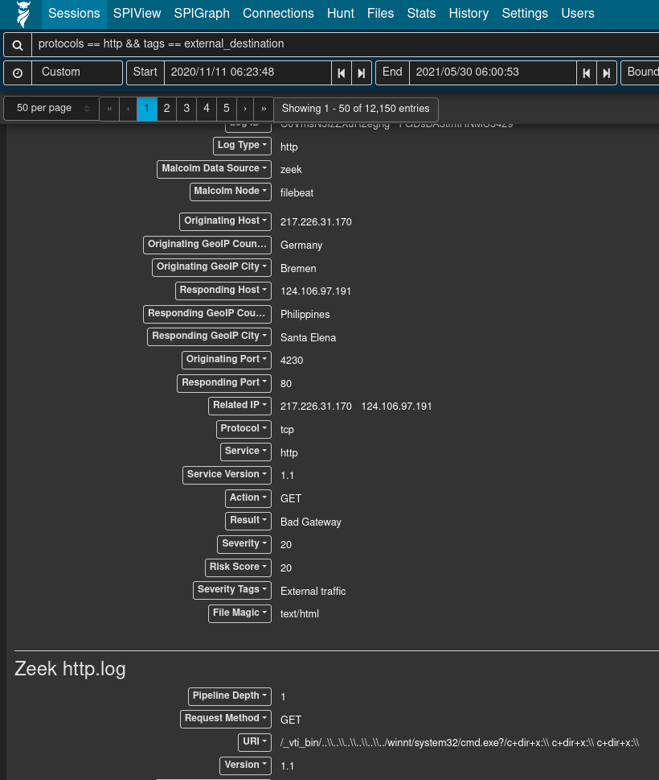
Sessions
Field-level details of sessions/logs matching filters
Similar to Dashboards’ Discover
Notes:
Arkime’s Sessions tab provides low-level details of the sessions being investigated (similar to Dashboards’s Discover interface), whether they be Arkime sessions created from PCAP files or Zeek logs mapped to the Arkime session database schema.
The set of fields present in the sessions table can be also customized, saved and later recalled.

Slide 45
Packet Payloads
Displayed for Arkime sessions with full PCAP (i.e., not Zeek logs)
File carving on the fly
Download session PCAP
Examine payload with CyberChef
Notes:
As mentioned, Arkime’s ability to tie a session record back to its original packet(s) is one of its greatest strengths. Details for individual sessions/logs can be expanded by clicking the plus ➕ icon on the left of each row. For Arkime session records, an additional Packets section will be visible underneath the metadata sections.
When the details of a session of this type are expanded, Arkime will read the packet(s) comprising the session for display here. Various controls can be used to adjust how the packet is displayed (enabling natural decoding and enabling Show Images & Files may produce visually pleasing results), and other options (including PCAP download, carving images and files, applying decoding filters, and examining payloads in CyberChef) are available.

Slide 46
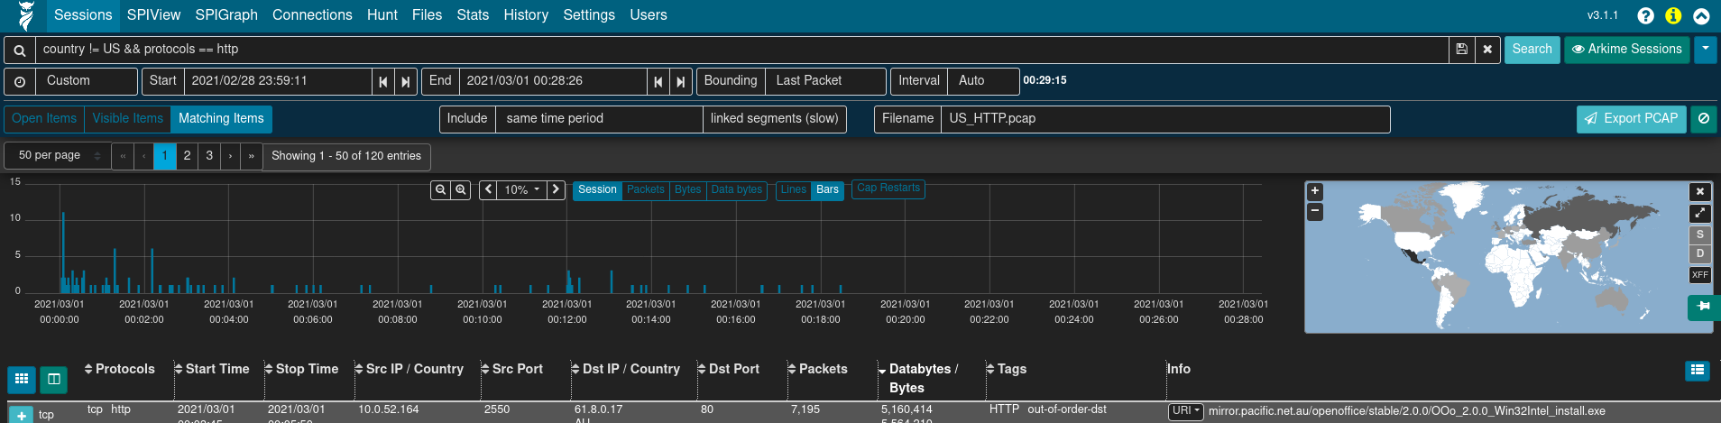
Export PCAP
Creates a new PCAP file from filtered sessions
Include open, visible or all matching sessions
Apply “Arkime Sessions” view to sessions first
Narrow as much as possible prior to exporting (huge PCAP files are a pain)
Notes:
Clicking the down arrow ▼ icon to the far right of the search bar presents a list of actions including PCAP Export.
When full PCAP sessions are displayed, the PCAP Export feature allows you to create a new PCAP file from the matching Arkime sessions, including controls for which sessions are included (open items, visible items, or all matching items) and whether or not to include linked segments. Click Export PCAP button to generate the PCAP, after which you'll be presented with a browser download dialog to save or open the file.
Note that depending on the scope of the filters specified this might take a long time (or, possibly even time out).

Slide 47
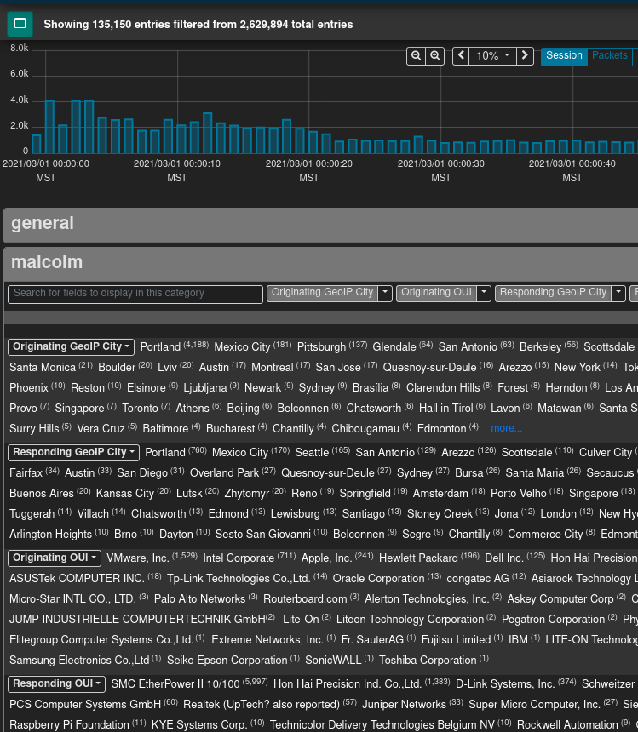
SPIView
Explore “top n” and field cardinality for all fields of both Arkime sessions and Zeek logs
Apply filters or pivot to Sessions or SPIGraph view for field values of interest
Limit search to ≤ 1
week before using
(it runs many queries)
Notes:
Arkime's SPI (Session Profile Information) View provides a quick and easy-to-use interface for exploring session/log metrics. The SPIView page lists categories for general session metrics (e.g., protocol, source and destination IP addresses, sort and destination ports, etc.) as well as for all of various types of network understood by Arkime and Zeek. These categories can be expanded and the top n values displayed, along with each value's cardinality, for the fields of interest they contain.
Click the the plus ➕ icon to the right of a category to expand it. The values for specific fields are displayed by clicking the field description in the field list underneath the category name. The list of field names can be filtered by typing part of the field name in the Search for fields dialog to display in this category text input. The Load All and Unload All buttons can be used to toggle display of all of the fields belonging to that category. Once displayed, a field's name or one of its values may be clicked to provide further actions for filtering or displaying that field or its values. Of particular interest may be the Open [fieldname] SPI Graph option when clicking on a field's name. This will open a new tab with the SPI Graph populated with the field's top values.
Note that because the SPIView page can potentially run many queries, SPIView limits the search domain to seven days (in other words, seven
indices, as each index represents one day's worth of data). When using SPIView, you will have best results if you limit your search time frame to less than or equal to seven days.

Slide 48
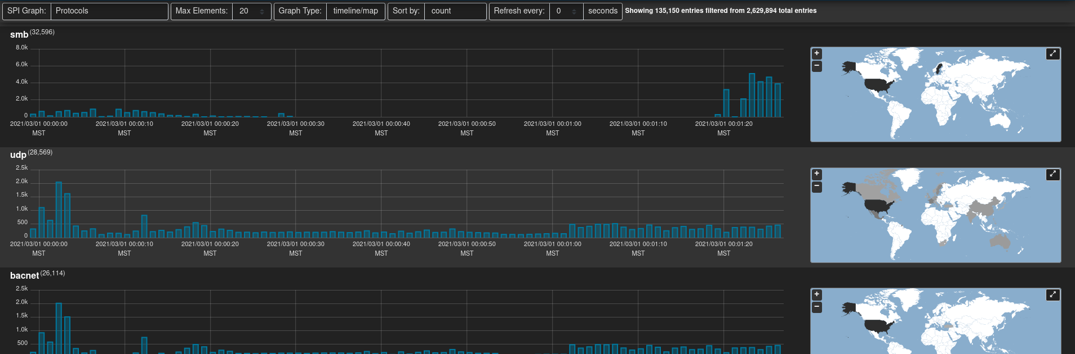
SPIGraph
View “top n” field values chronologically and geographically
Identify trends and patterns in network traffic
Notes:
Arkime's SPI (Session Profile Information) Graph visualizes the occurrence of some field's top n values over time, and (optionally) geographically. This is particularly useful for identifying trends in a particular type of communication over time: traffic using a particular protocol when seen sparsely at regular intervals on that protocol's date histogram in the SPIGraph may indicate a connection check, polling, or beaconing (for example, see the llmnr protocol in the screenshot).
Controls can be found underneath the time bounding controls for selecting the field of interest, the number of elements to be displayed, the sort order, and a periodic refresh of the data.

Slide 49
Connections
Visualize logical relationship between hosts
Use any combination of fields for source and destination nodes
Compare current vs. previous (baseline) traffic
Notes:
The Connections page presents network communications via a force-directed graph, making it easy to visualize logical relationships between network hosts.
Controls are available for specifying the query size (where smaller values will execute more quickly but may only contain an incomplete representation of the top n sessions, and larger values may take longer to execute but will be more complete), which fields to use as the source and destination for node values, a minimum connections threshold, and the method for determining the "weight" of the link between two nodes. As is the case with most other visualizations in Arkime, the graph is interactive: clicking on a node or the link between two nodes can be used to modify query filters, and the nodes themselves may be repositioned by dragging and dropping them. A node's color indicates whether it communicated as a source/originator, a destination/responder, or both.
While the default source and destination fields are Src IP and Dst IP:Dst Port, the Connections view is able to use any combination of any of the fields populated by Arkime and Zeek. For example:
Src OUI and Dst OUI (hardware manufacturers)
Src IP and Protocols
Originating Network Segment and Responding Network Segment
Originating GeoIP City and Responding GeoIP City
or any other combination of these or other fields.
A recent addition to this feature (and one developed specifically for Malcolm and then contributed back upstream to the Arkime project) is the ability to specify a “baseline” time frame in the Connections view to visualize changes to a network over time (e.g., new hosts or protocols appearing in your network). This feature is mainly useful if you have prior long-term packet captures available in orde to establish baseline against which current traffic may be compared.

Slide 50
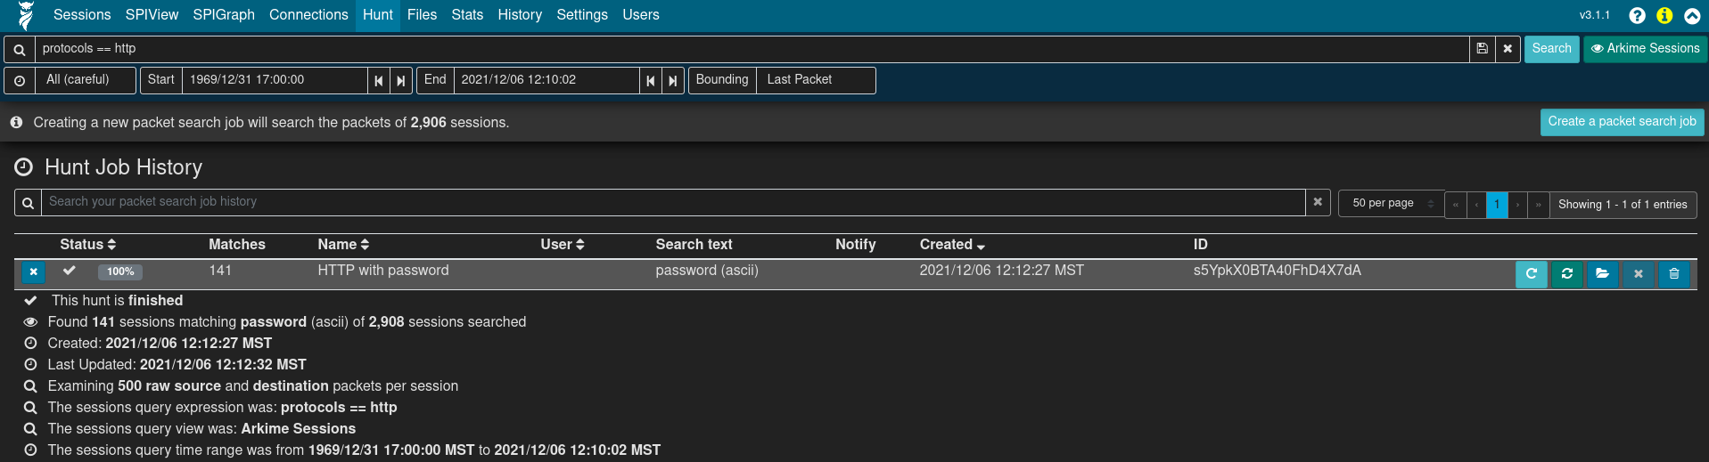
Packet Search (“Hunt”)
Deep-packet search (“PCAP grep”) of session payloads
Search for ASCII, hex codes or regular expression matches
Apply “Arkime Sessions” view to sessions first
Notes:
Arkime's Hunt feature allows an analyst to search within the packets themselves (including payload data) rather than simply searching the session metadata. The search string may be specified using ASCII (with or without case sensitivity), hex codes, or regular expressions. Once a hunt job is
complete, matching sessions can be viewed in the Sessions view.
Clicking Create a packet search job on the Hunt page will allow you to specify the following parameters for a new hunt job:
a packet search job name
a maximum number of packets to examine per session
the search string and its format (ascii, ascii (case sensitive), hex, regex, or hex regex)
whether to search source packets, destination packets, or both
whether to search raw or reassembled packets
Click the ➕ Create button to begin the search. Arkime will scan the source PCAP files from which the sessions were created according to the search criteria. Note that whatever filters were specified when the hunt job is executed will apply to the hunt job as well; the number of sessions matching the current filters will be displayed above the hunt job parameters with text like "ⓘ Creating a new packet search job will search the packets of # sessions.”
Once a hunt job is submitted, it will be assigned a unique hunt ID (a long unique string of characters like yuBHAGsBdljYmwGkbEMm) and its progress will be updated periodically in the Hunt Job Queue. More details for the hunt job can be viewed by expanding its row with the plus ➕ icon on the left.
When the hunt job is complete (and a minute or so has passed, as the huntId must be added to the matching session records in the database), click the folder icon on the right side of the hunt job row to open a new Sessions tab with the search bar prepopulated to filter for sessions with packets matching the search criteria. From this list of filtered sessions you can expand session details and explore packet payloads which matched the hunt search criteria.
The hunt feature is available only for sessions created from full packet capture data, not Zeek logs. This being the case, it is a good idea to click the eyeball 👁 icon and select the PCAP Files view to exclude Zeek logs from candidate sessions prior to using the hunt feature.

Slide 51
Exercise: Examine PCAP data in Arkime
Identify the top network device hardware manufacturers (by OUI, organizationally unique identifier) in SPIView.
Identify the top network services (protocols) in SPIView where either side of the connection is a publicly routable IP address.
Use SPIGraph to view the top HTTP user agent strings chronologically and geographically. Identify items of concern.
Use the Connections view to view Zeek connections (conn.log entries) grouping by originating and responding network segments. Then, change the destination node to represent the application protocol (service).
In the sessions view, list HTTP sessions for which full PCAP payload is available. Narrow to connections which transmitted at least 8 kilobytes of data. Export a PCAP file containing all matching sessions.
In the sessions view, view HTTP sessions where Windows PowerShell (.ps1) scripts were uploaded or downloaded. Examine the packet payload of one of these sessions to view the contents of one of these scripts.
Notes:
As mentioned, Arkime’s ability to tie a session record back to its original packet(s) is one of its greatest strengths. Details for individual sessions/logs can be expanded by clicking the plus ➕ icon on the left of each row. For Arkime session records, an additional Packets section will be visible underneath the metadata sections.
When the details of a session of this type are expanded, Arkime will read the packet(s) comprising the session for display here. Various controls can be used to adjust how the packet is displayed (enabling natural decoding and enabling Show Images & Files may produce visually pleasing results), and other options (including PCAP download, carving images and files, applying decoding filters, and examining payloads in CyberChef) are available.

Slide 52
Data Source Correlation
Search syntax is different between Arkime and Dashboards
(and in some cases, so are field names)
  See search syntax comparison table, Malcolm and Arkime docs
Despite considerable overlap, there are
differences in protocol parser support
among Zeek, Suricata and Arkime
  Learning the strengths of each will help
  you more effectively find the good stuff
Notes:
Although Malcolm’s Dashboards and Arkime interfaces provide two different views into the same network data, there are a few notable differences between the two:
The Arkime and Dashboards search syntax is different.
Arkime uses its own field names in its user interface: for example, searching protocols == http in Arkime is equivalent to searching protocol:http in Dashboards. Enabling Display Database Fields in the Fields section of Arkime’s help can help you map them.
Despite considerable overlap, there are differences in protocol parser support between Zeek and Arkime. In particular, Malcolm’s configuration of Zeek parses many more ICS protocols than Arkime.

Slide 53
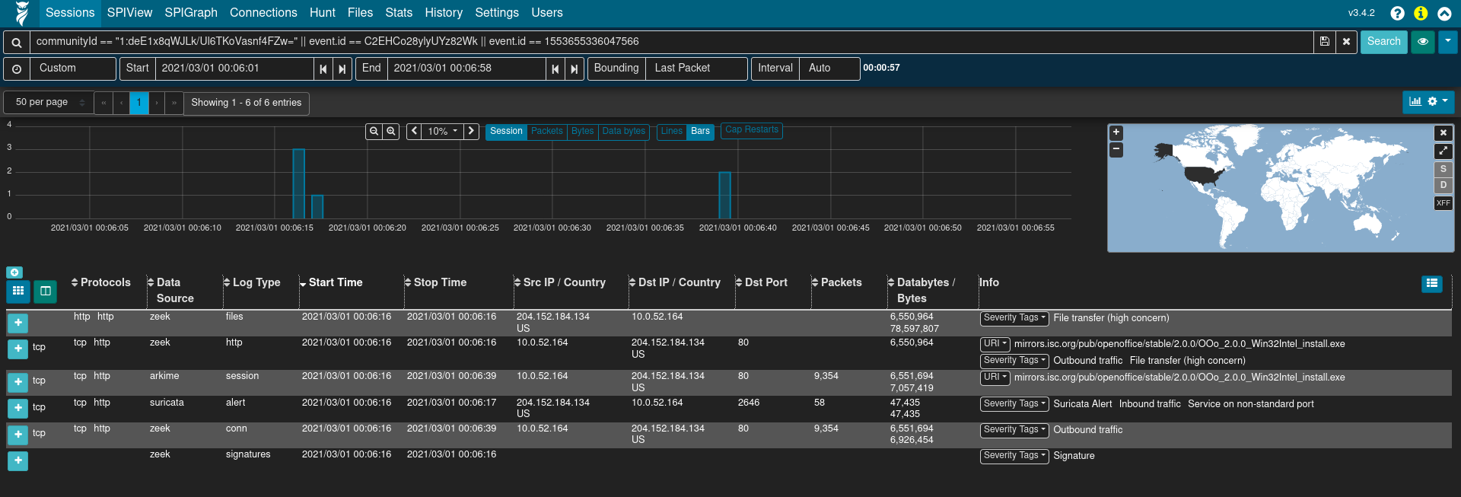
Correlate Zeek or Suricata Logs and Packet Payloads
Correlate Zeek or Suricata logs and Arkime sessions using common fields
communityId fingerprints flows to bridge data sources
rootId/event.id filters logs for the same session
Filter community ID OR’ed with event.id to see all Arkime sessions and Zeek or Suricata logs for the same traffic
communityId == "1:r7tGG//fXP1P0+BXH3zXETCtEFI=" || event.id == "CQcoro2z6adgtGlk42"
Notes:
As previously discussed, Arkime generates session records containing metadata about network connections. Zeek generates similar session metadata, linking network events to sessions via a connection UID. Malcolm aims to facilitate analysis of Zeek logs by mapping values from Zeek logs to the Arkime session database schema for equivalent fields, and by creating new "native" Arkime database fields for all the other Zeek log values for which there is not currently an equivalent in Arkime. The Fields section of Arkime’s help provides a list of known fields across both the Arkime and Zeek data sources.
In this way, when full packet capture is an option, analysis of PCAP files can be enhanced by the additional information Zeek provides. When full packet capture is not an option, similar analysis can still be performed using the same interfaces and processes using the Zeek logs alone. The values of records created from Zeek logs can be expanded and viewed like any native Arkime session by clicking the plus ➕ icon to the left of the record in the Sessions view. However, note that when dealing with these Zeek records the full packet contents are not available, so buttons dealing with viewing and exporting PCAP information will not behave as they would for records from PCAP files. Other than that, Zeek records and their values are usable in Malcolm just like native PCAP session records.
A few fields of particular mention that help limit returned results to those Zeek logs and Arkime session records generated from the same network connection are Community ID and Zeek's connection UID (zeek.uid), which Malcolm maps to Arkime’s rootId field.
Community ID is a specification for standard flow hashing published by Corelight with the intent of making it easier to pivot from one dataset (e.g., Arkime sessions) to another (e.g., Zeek conn.log entries). In Malcolm both Arkime and Zeek populate this value, which makes it possible to filter for a specific network connection and see both data sources' results for that connection.
The rootId field is used by Arkime to link session records together when a particular session has too many packets to be represented by a single session. When normalizing Zeek logs to Arkime's schema, Malcolm piggybacks on rootId to store Zeek's connection UID to crossreference entries across Zeek log types. The connection UID is also stored in zeek.uid.
Filtering on community ID OR'ed with zeek UID (e.g., communityId == "1:r7tGG//fXP1P0+BXH3zXETCtEFI=" || rootId == "CQcoro2z6adgtGlk42") is an effective way to see both the Arkime sessions and Zeek logs generated by a particular network connection.

Slide 54
Exercise: Dashboards to Arkime Session Trace
In Dashboards, identify and filter for the connection UID (rootId or event.id) the earlier of two transfers of files with the application/x-executable MIME type.
Review Dashboards with information pertinent to this session.
Pivot from Dashboards to Arkime on the connection UID.
In the Arkime Sessions view, list all relevant records relating to this session, both Zeek logs and Arkime sessions.
Examine the payload of the session and download its PCAP.
Notes:
As mentioned, Arkime’s ability to tie a session record back to its original packet(s) is one of its greatest strengths. Details for individual sessions/logs can be expanded by clicking the plus ➕ icon on the left of each row. For Arkime session records, an additional Packets section will be visible underneath the metadata sections.
When the details of a session of this type are expanded, Arkime will read the packet(s) comprising the session for display here. Various controls can be used to adjust how the packet is displayed (enabling natural decoding and enabling Show Images & Files may produce visually pleasing results), and other options (including PCAP download, carving images and files, applying decoding filters, and examining payloads in CyberChef) are available.

Slide 55
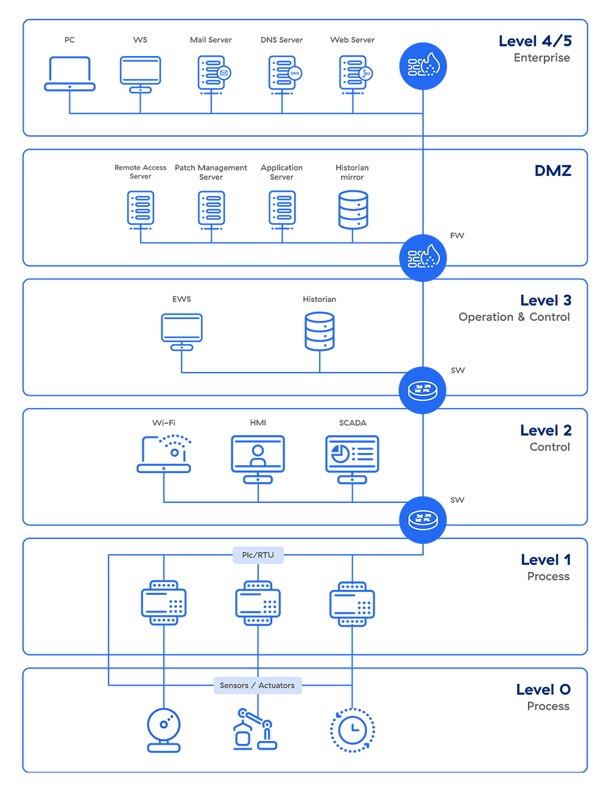
Verify Network Segmentation with NetBox and Asset Interaction Analysis
Flat networks are problematic (and unfortunately common)
Security-minded network design incorporates segregating (isolating) and segmenting (dividing) assets into zones with differing levels of trust and well-defined boundaries
Enterprise
DMZ
Operation and Control
Supervisory Control
Process
etc.
Image credit: Zscaler.com

Slide 56
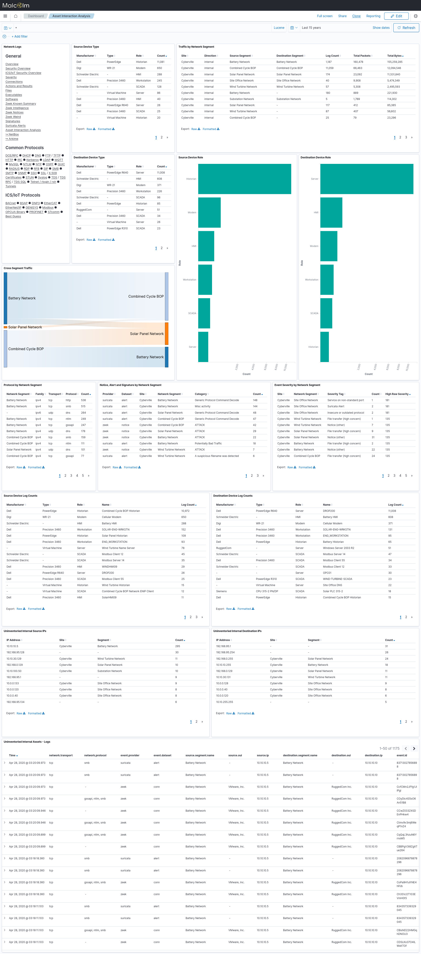
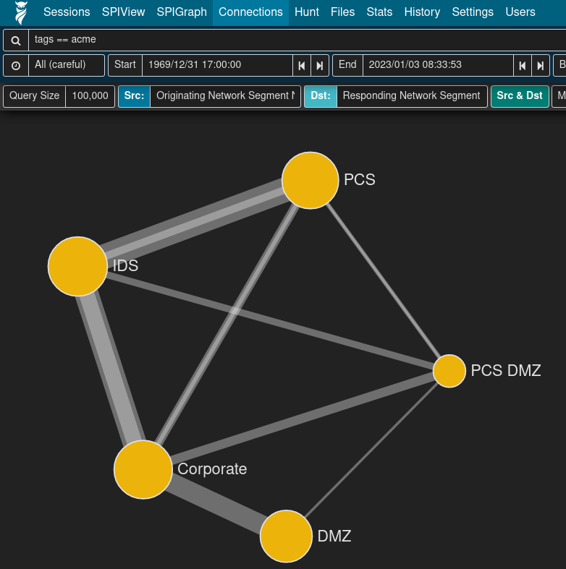
Verify Network Segmentation with NetBox and Asset Interaction Analysis
Network prefixes are identified by name and CIDR subnet in NetBox
Observed network traffic is cross-referenced against inventory
Malcolm dashboards such as Asset Interaction Analysis highlight relationships among network segments

Slide 57
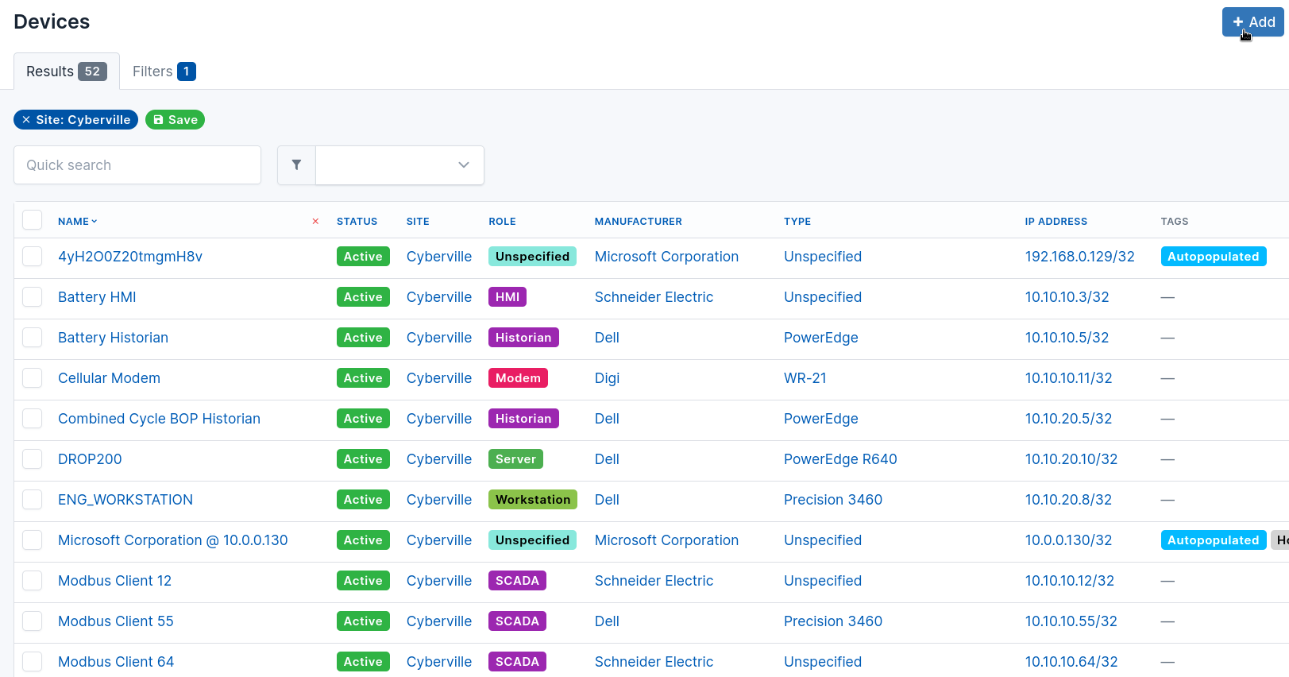
Pinpoint Rogue Devices and Services
Networked devices can be inventoried in NetBox
  Name
  IP address
  Manufacturer
  SKU or model number
  Role
Expected services (application protocols) can be specified for the devices that provide them

Slide 58
Pinpoint Rogue Devices and Services
Dashboards highlight “uninventoried” devices and services (observed but not accounted for in NetBox)
  Zeek Known Summary
  Asset Interaction Analysis
Premade Arkime views
  Uninventoried Internal Assets
  Uninventoried Observed Services

Slide 59
Survey East-West and North-South Traffic
network.direction field
  internal: East-West
  inbound: “Southbound”
  outbound: “Northbound”
North-South
East-West

Slide 60
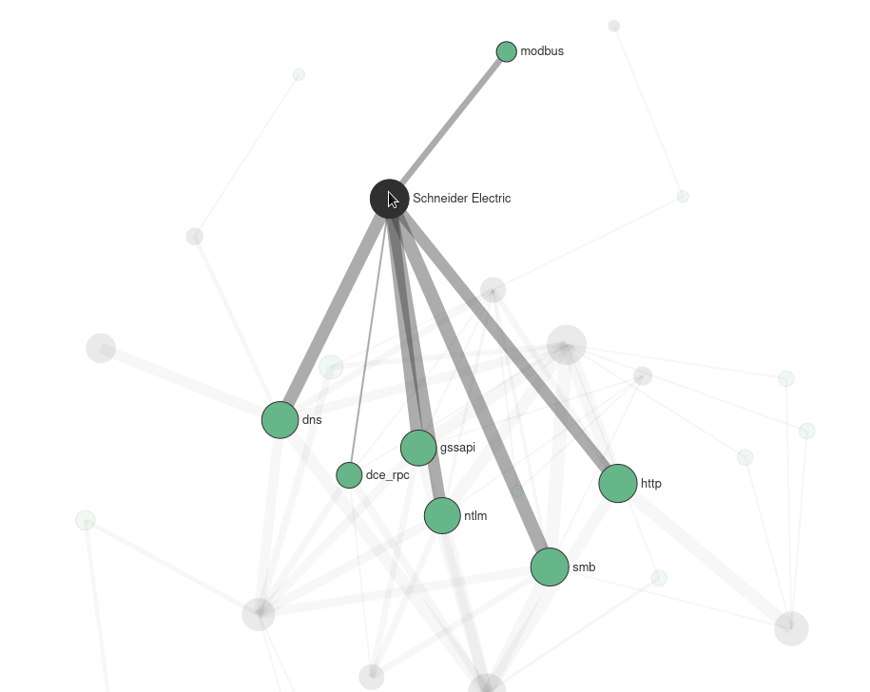
Review Observed Network Protocols
Unsecure or outdated protocols
Unexpected protocols (traffic that should not be present in a network segment)
    IPv6
    DNS
    DHCP
    Remote desktop
    Automatic software updates
SSH < v2 TLS < v1.2 NTP < v4 VNC < v3.8 RDP < v6 | LDAP < v3 FTP/TFTP SMB < v3 telnet/rlogin/rsh etc.

Slide 61
Investigate Suspicious File Transfers
File Scanning
File transfers are detected in network traffic
  SMB/CIFS (Windows file shares)
  SMTP (Email)
  HTTP (Web downloads)
  etc.
Files automatically extracted by Zeek and scanned with Strelka
  YARA - general-purpose scanner to identify and classify malware
  ClamAV - antimalware toolkit able to detect many types of malware, including viruses
  capa - executable capabilities analyzer
  Dozens of other customizable scanners
Notes:
As mentioned earlier, Zeek has the ability to “carve” files from a variety of protocols in observed network traffic. Malcolm leverages this feature to submit these carved files to a number of file scanning tools:
ClamAV – an open source antivirus engine to scan for known malware signatures
YARA – pattern matching swiss army knife using a curated list of security-related signatures or your own custom signatures
Capa – portable executable capabilities analyzer
VirusTotal – online database of file hashes (requires API token and internet connection)
This can be set globally as the default behavior (by modifying a configuration file in the Malcolm install directory prior to starting up) or on a per-PCAP basis when uploading using the upload web UI interface.
Malcolm can be configured to preserve files carved from network traffic (either all files or just “suspicious” ones that trigger the scanning engines) for further examination.

Slide 62
File Scanning Dashboard
Summarizes hits from file scanning engines and provides full Strelka scan reports for files extracted from network traffic.
Notes:
As mentioned earlier, Zeek has the ability to “carve” files from a variety of protocols in observed network traffic. Malcolm leverages this feature to submit these carved files to a number of file scanning tools:
ClamAV – an open source antivirus engine to scan for known malware signatures
YARA – pattern matching swiss army knife using a curated list of security-related signatures or your own custom signatures
Capa – portable executable capabilities analyzer
VirusTotal – online database of file hashes (requires API token and internet connection)
This can be set globally as the default behavior (by modifying a configuration file in the Malcolm install directory prior to starting up) or on a per-PCAP basis when uploading using the upload web UI interface.
Malcolm can be configured to preserve files carved from network traffic (either all files or just “suspicious” ones that trigger the scanning engines) for further examination.

Slide 63
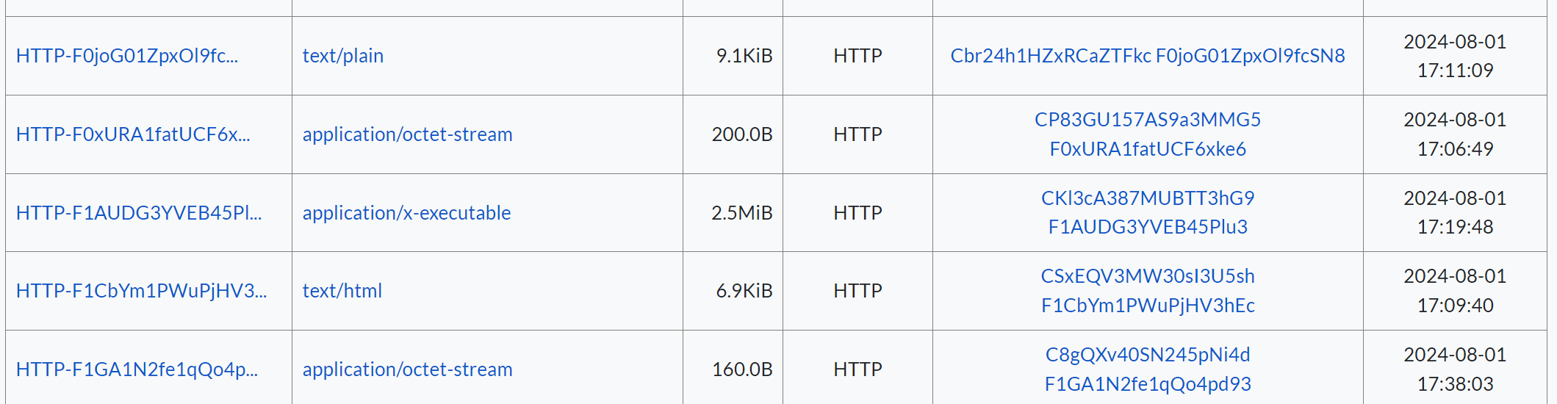
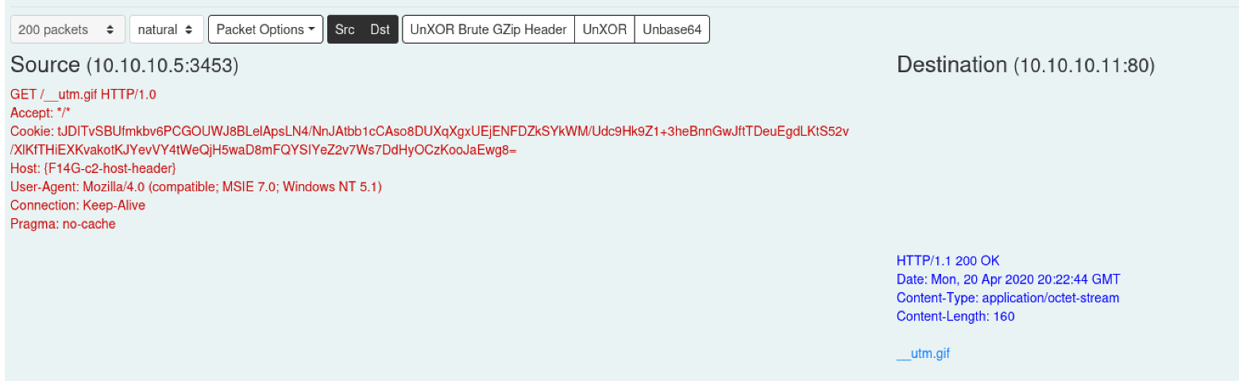
File Transfers: Preserved Files
Files identified as potentially malicious are flagged and optionally preserved for further investigation
Notes:
As mentioned earlier, Zeek has the ability to “carve” files from a variety of protocols in observed network traffic. Malcolm leverages this feature to submit these carved files to a number of file scanning tools:
ClamAV – an open source antivirus engine to scan for known malware signatures
YARA – pattern matching swiss army knife using a curated list of security-related signatures or your own custom signatures
Capa – portable executable capabilities analyzer
VirusTotal – online database of file hashes (requires API token and internet connection)
This can be set globally as the default behavior (by modifying a configuration file in the Malcolm install directory prior to starting up) or on a per-PCAP basis when uploading using the upload web UI interface.
Malcolm can be configured to preserve files carved from network traffic (either all files or just “suspicious” ones that trigger the scanning engines) for further examination.

Slide 64
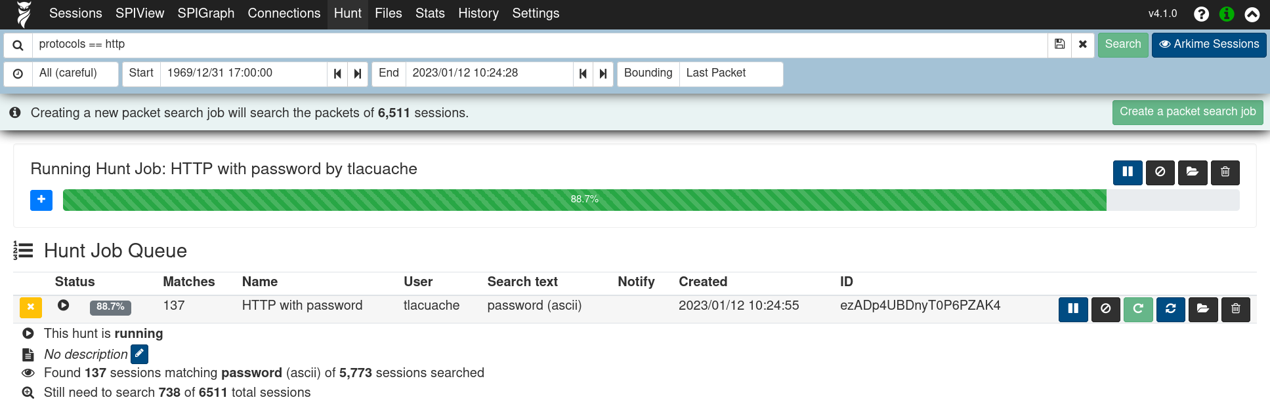
Examine Sensitive Unencrypted Data
Observed cleartext credentials are normalized (e.g., related.user and related.password) for ease of locating them across protocols
Arkime Hunt feature can deep-packet search session payloads for strings, hex codes, or regular expression matches
Notes:
As mentioned earlier, Zeek has the ability to “carve” files from a variety of protocols in observed network traffic. Malcolm leverages this feature to submit these carved files to a number of file scanning tools:
ClamAV – an open source antivirus engine to scan for known malware signatures
YARA – pattern matching swiss army knife using a curated list of security-related signatures or your own custom signatures
Capa – portable executable capabilities analyzer
VirusTotal – online database of file hashes (requires API token and internet connection)
This can be set globally as the default behavior (by modifying a configuration file in the Malcolm install directory prior to starting up) or on a per-PCAP basis when uploading using the upload web UI interface.
Malcolm can be configured to preserve files carved from network traffic (either all files or just “suspicious” ones that trigger the scanning engines) for further examination.

Slide 65

Towards the Future
Hunt- and IR-focused analytics and correlation capabilities Support generic (Sigma) rules and analytics Cross-reference against Common Security Advisory Framework (CSAF) and KEV (Known Exploited Vulnerabilities) catalog | Improve cloud deployment Improve upgrade workflow Revamp installation/configuration tool with GUI Distributed rule/policy management for network sensors Explore the possibility of ML/AI/LLM integrations Improve integration and correlation of third-party and host logs Increase OT/ICS protocol support
Notes:
Operational technology (OT) is responsible for processes that, if compromised, could impact outages of critical services that result in loss of life. As such, effective OT network security is imperative. Here are some tips for assessing the security of OT networks in Malcolm:
Identify cross-segment traffic in Malcolm by defining network segments using the Host and Network Segment Name Mapping interface prior to indexing data, then searching the tags field for cross_segment
Identify connections between internal networks and the internet by searching Zeek log tags for external_source and external_destination in either Dashboards or Arkime, or by using the Public IP Addresses view in Arkime
Use the ICS/IoT Security Overview dashboard to identify ICS protocols and their usage across network segments.
Identify protocols and file transfers and their usage patterns. Malcolm’s Overview, Security Overview, ICS/IoT Security Overview and Files dashboards in Dashboards can help. Pay particular attention to remote session protocols (remote desktop, SSH, telnet, etc.) and identify protocols not generally used in OT networks.
Use the Overview and Security Overview dashboards to identify application protocols that are outdated or using insecure versions.

Slide 66

Thank you!
Visit Malcolm on GitHub to read the docs, make suggestions, report issues and st★r to show your support!
Malcolm is open-source software developed at Idaho National Lab
© 2026 Battelle Energy Alliance, LLC

